Slide 1
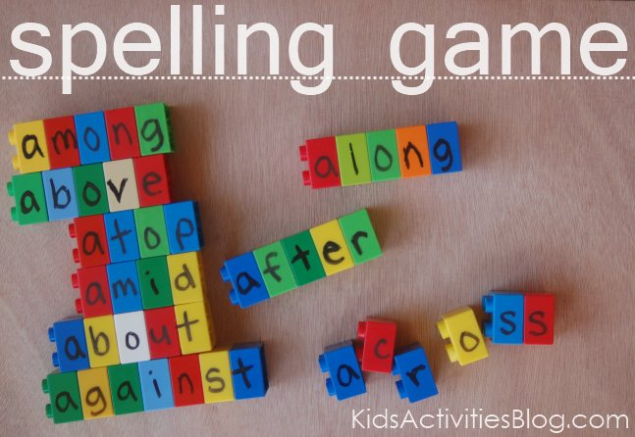
Good Morning!
Welcome to the Lower Key Stage Two Spelling and Reading Workshop.
Today’s session is designed to show you some fun activities/games that you can use at home. They are things your children do in school and they help encourage spelling and reading skills.

Slide 2
Spelling Activities

Slide 3
Word Unscramble
Works well when word list has common feature(s).
Children can sort those common letters. That then makes it easier to unscramble the rest of the letters.
e.g. all words ending ‘’ent.”
Iesltn =
tfederfni =
silent
different

Slide 4
Try it yourselves!
Look at the WORD UNSCRAMBLE task.
All the words end in ‘ing.’ Sort the i-n-g first then unjumble the letters that you have left.
tiknag iggno lisigmn
lugnibid ghruins

Slide 5
Complete the Table
Any column can be left blank, encouraging children to think, in depth, about the nature of the rule.
Root word | suffix | New word
chase | ing | chasing
? | ing | slicing
take | ? | taking
joke | ing | ?
? | ed | joked
chase | ed | ?
? | ies | puppies

Slide 6
Missing Letters
Works well when the word list is random e.g. the Year 3/4 Spelling List
set the challenge for their partner to complete.
guide, ordinary, guard, heart,
early.
ordin_ry
g _ ide
h _ art

Slide 7
Missing Letters
Try it yourselves!
bel_eve actu_l
g_ard run_ing

Slide 8
Word Art
d
de
def
defi
defin
defini
definit
definite
definitel
definitely
physical
On the blank paper,
try some yourselves with words from the Year 3/4 Spelling List.

Slide 9
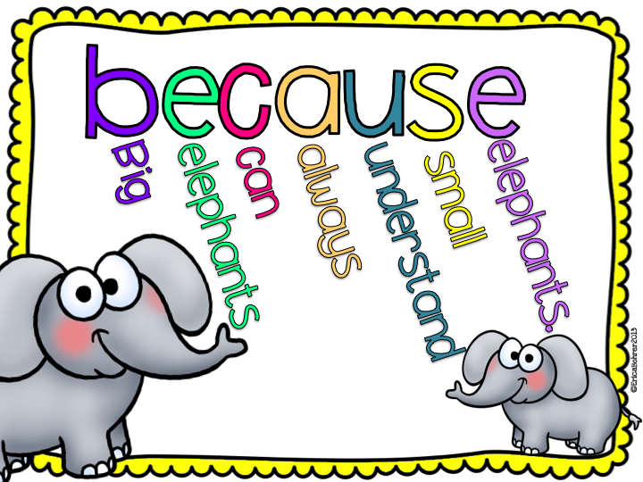
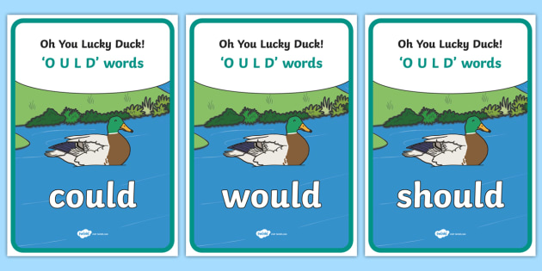
Pnemonics

Slide 10
“Hangman” Game

Slide 11
Noughts and Crosses
build
build
guide
guide
build
Try it yourselves!
Choose a word each from the Year 3/4 Spelling List.
The first person to correctly spell three in a row wins.

Slide 12
Stretch A Sentence
We studied a graph, in geography, and then read a pamphlet about elephants and dolphins.
This is a sentence made of several words that your child may be studying that week, or words from the Year 3/4 Spelling List.

Slide 13
Reading
One way you can get involved with your child’s reading is to play skim and scan games.
Scanning a page/skim reading is a very important skill for finding important information.

Slide 14
Reading
Skim and Scan – Themed Words
e.g. This person has been asked to find all the words around the theme of rivers.
source mouth riverbed confluence tributary stream current
Try it yourselves.
Look at the multi-coloured word list and tick all of the words that fit the theme of school uniform.

Slide 15
Reading
Skim and Scan – Find The Word…
Find The Word
Find the word…
‘devices’
A lot of road safety is just plain common sense but sometimes we have other things on our minds and common sense takes a back seat! When out near roads you have to keep your wits about you and not become distracted.
Many people use mobile devices when they are walking and these can seriously distract your attention from the road.

Slide 16
Reading
Bookmarks for home reading
Bookmarks will be given out at Parents’ Evening.
They have a range of comprehension questions written on them.
Choose two or three to ask your child.
The questions are separated into two lists: ‘before reading’ and ‘after reading.’
The questions are designed to hone a range of reading skills.

Slide 17
Thank you for listening and getting involved!
Any questions?

