Slide 2
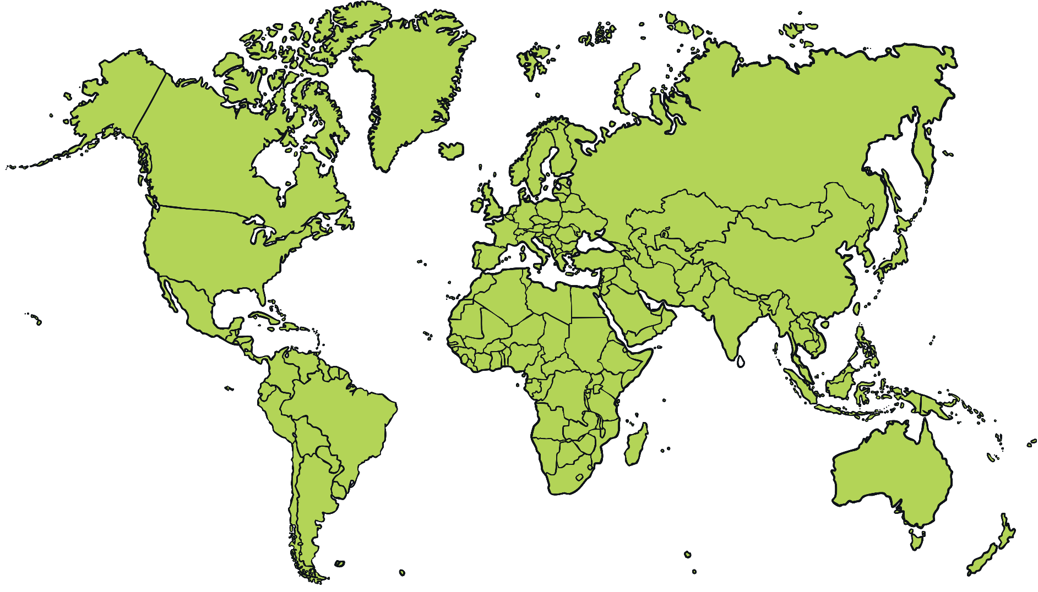
Christmas Around the World

Slide 3
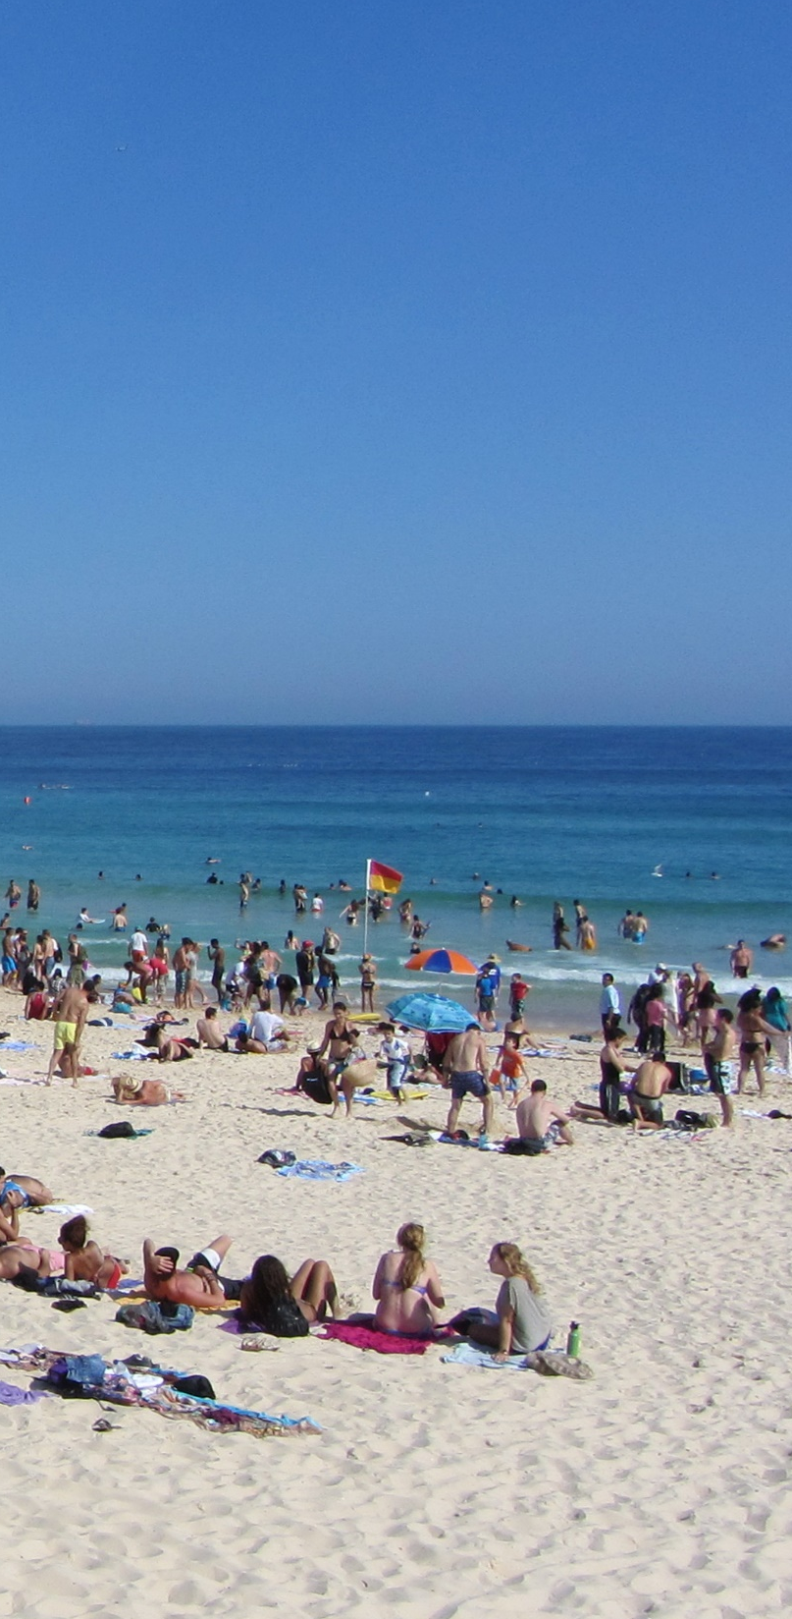

Christmas Around the World
Australia
The temperature in Australia on Christmas Day can range between 30-40°C with the hottest temperature recorded on Christmas Day in South Australia at 40.7°C.
Children have their summer holidays from mid-December through to early February
Some people go camping over Christmas!
Bondi Beach is famous for families having their Christmas lunch on the beach.
A typical Christmas menu could include seafood, glazed ham, cold chicken, duck or turkey, cold deli meats, pasta, salads, desserts of all types, fruit salad, ice cream plus Christmas treats such as mince pies. Some Australian families follow tradition of a roast dinner and Christmas pudding even in the warm summer weather.
“Bondi Beach, Sydney” by Robert Linsdell is licensed under CC BY 2.0

Slide 4
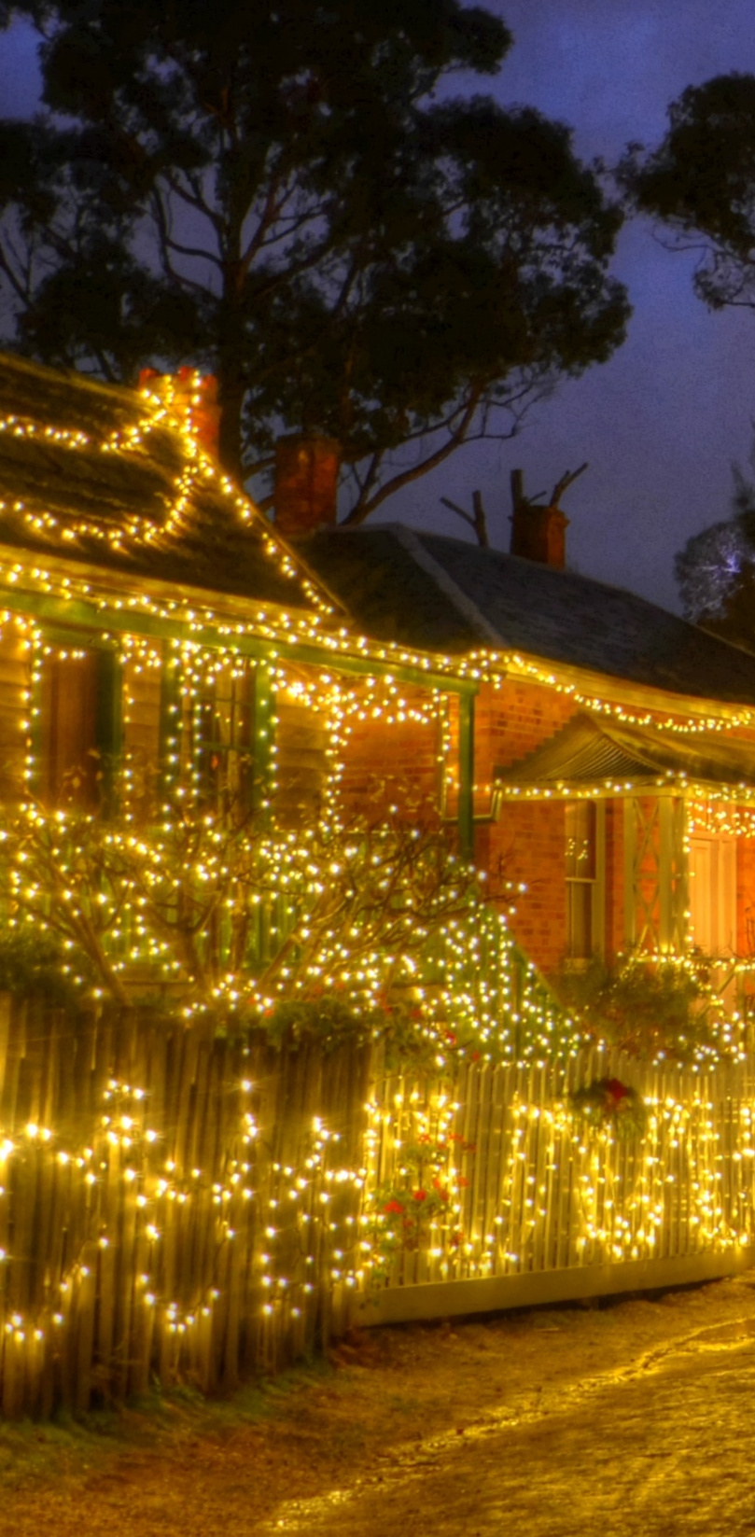

Christmas Around the World
Australia
Some Australian families have the tradition of creating Christmas light displays in their streets for everyone to enjoy. One street in Sydney has raised more than $35,000 for charity by charging an entry fee to see their light displays on the homes in the street.
When Santa gets to Australia he changes into a t-shirt, shorts and thongs (flip-flops). He then gives his reindeers a rest, calling on the help of his kangaroo friends or as they are known as the ‘Six White Boomers’ (a popular Australian Christmas carol).
“Sppedwell Street Fairy Lights” by Chris Fithall is licensed under CC BY 2.0

Slide 5
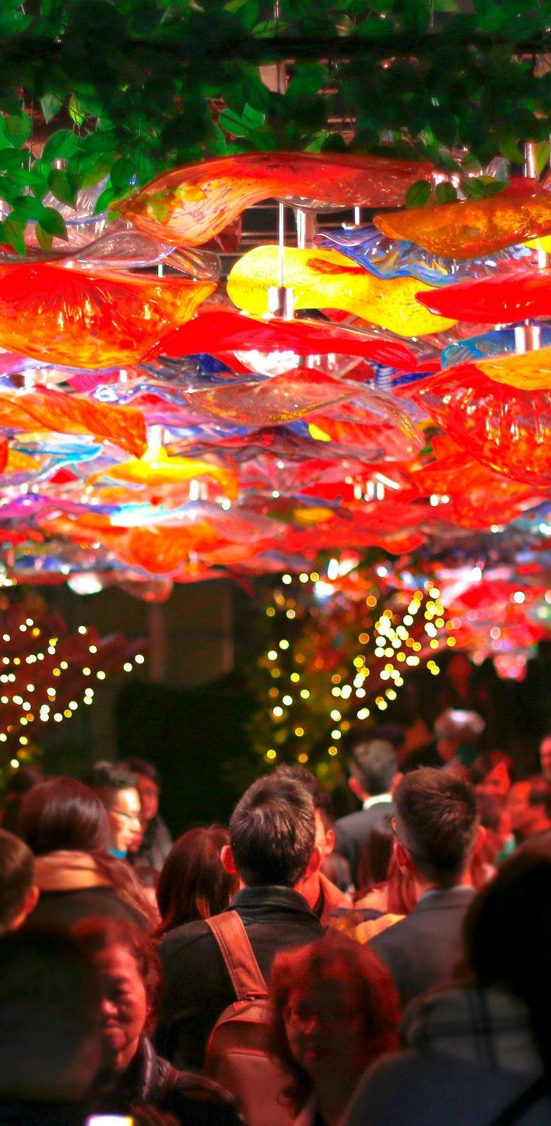
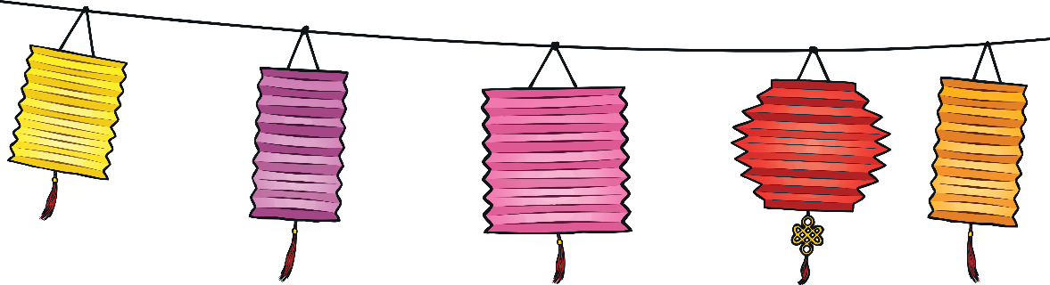
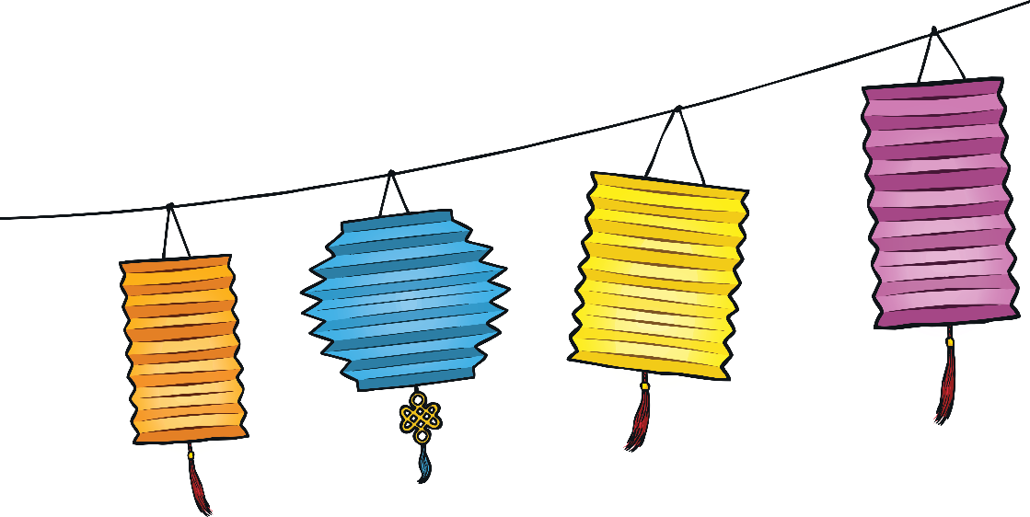
Christmas Around the World
China
Christians in China often celebrate by lighting their houses with paper lanterns.
Christmas trees are called ‘trees of light’ and are decorated with paper chains, paper flowers and paper lanterns.
Lots of people in China do not celebrate Christmas. The main winter festival is called Chinese New Year and takes place in February. Many Chinese people worship their ancestors during Chinese New Year.

Slide 6
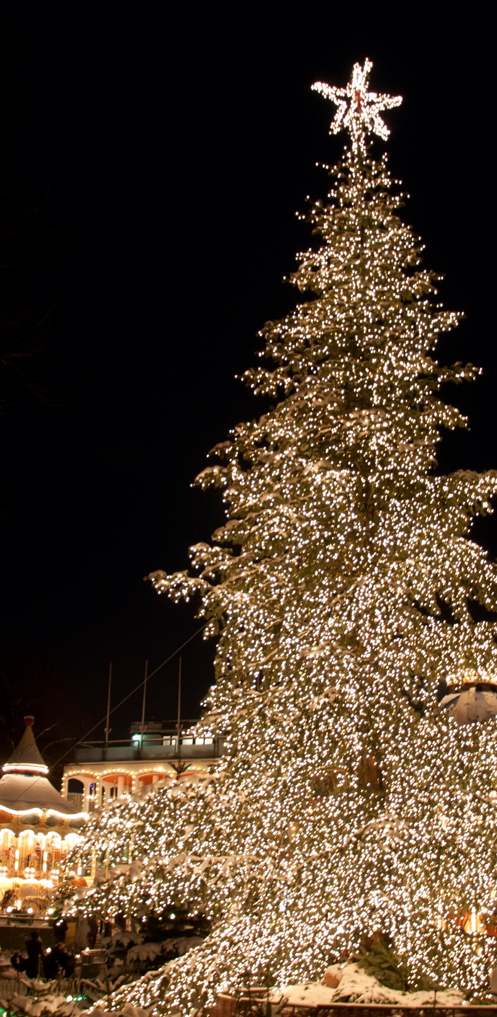
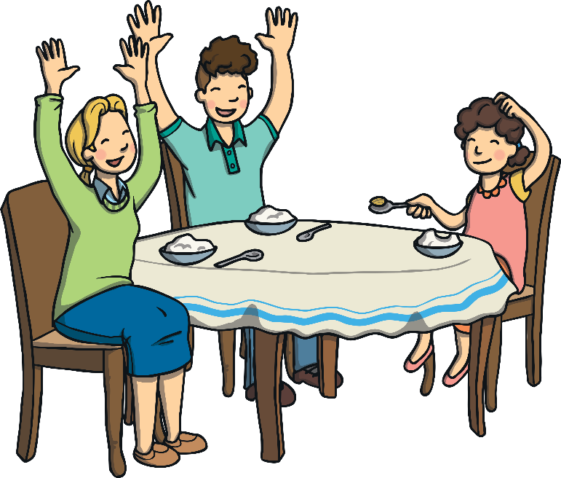
Christmas Around the World
Denmark
The Christmas feast in Denmark is usually celebrated at midnight on Christmas Eve.
It is common to have special rice pudding dessert in which a single almond is hidden. Whoever finds the almond will have good luck for a whole year.
Instead of Santa Claus, the bringer of gifts in Denmark is known as Julemanden.
Julemanden arrives in a sleigh drawn by reindeer and a sack over his back.
Julemanden has lots of elf helpers, named Juul Nisse, who are said to live in attics.
“Christmas Tree” by Kristian Mollenborg is licensed under CC BY 2.0

Slide 7
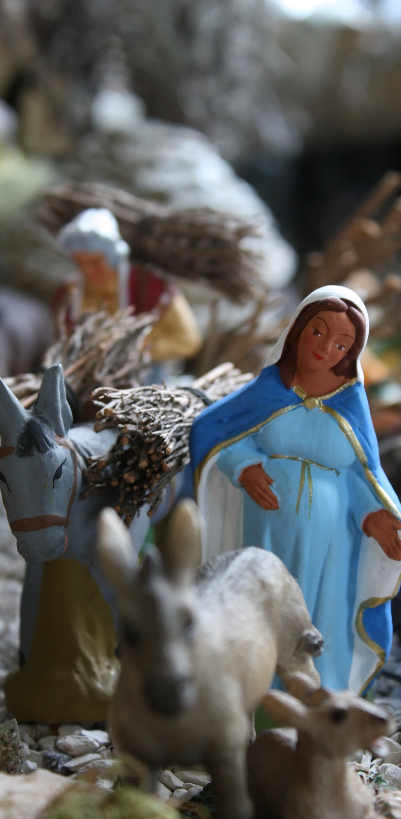
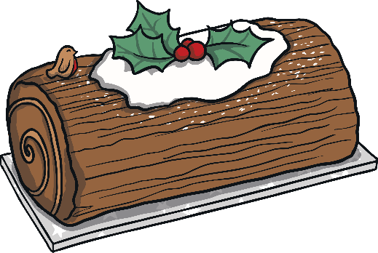
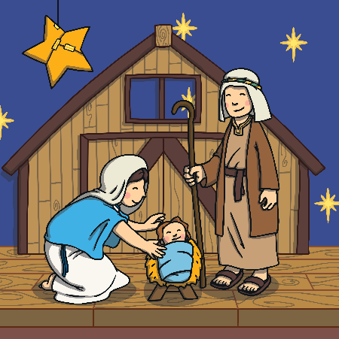
Christmas Around the World
France
Most French homes at Christmas time have nativity displays with clay figures called santons. Craftsmen make the santons all throughout the year to sell at annual Christmas fairs.
Many homes also display a festive wreath and a Christmas tree.
Many people in France celebrate by making a traditional log shaped cake called a ‘bûche de Noël’ (Christmas log).
“Crèche - Marie enceinte“ by Eusebius is licensed under CC BY 2.0

Slide 8
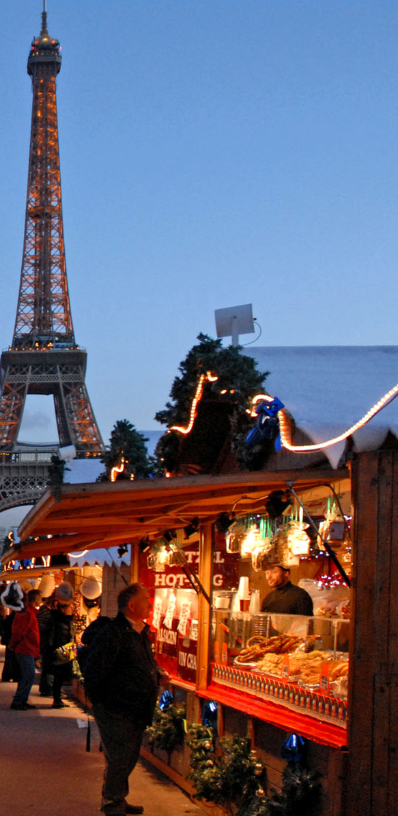
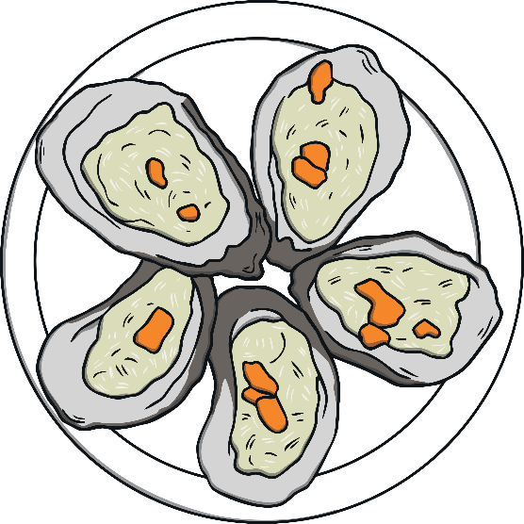
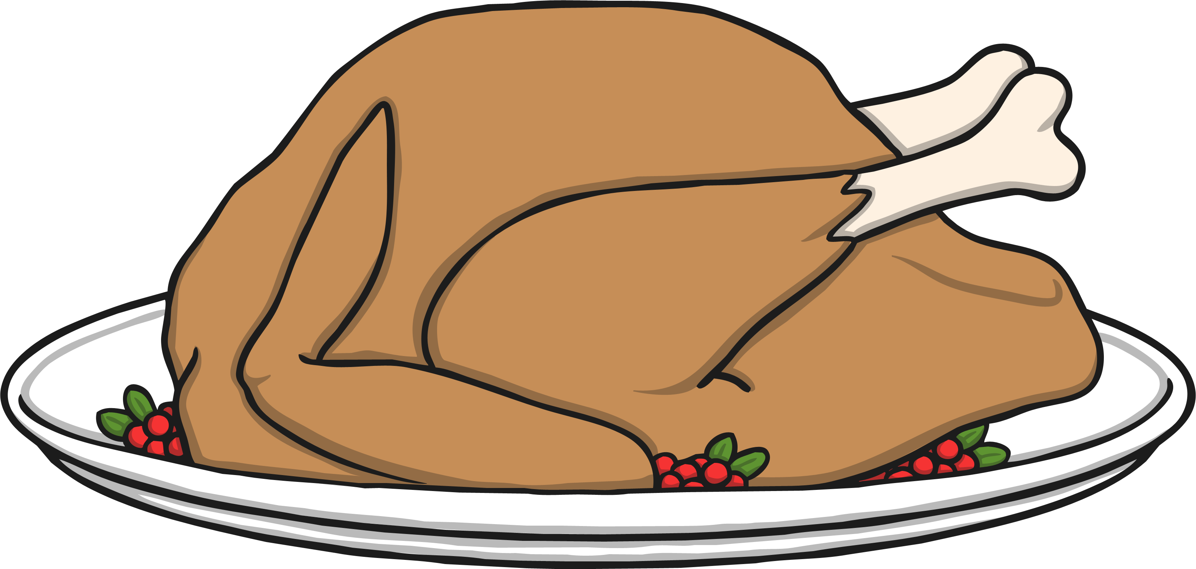
Christmas Around the World
France
Christmas dinner varies in different parts of France. Some favourites are goose, turkey and oysters.
Many French children receive gifts from Père Noël. He travels with a stern friend, Père Fouettard, who reminds him how well behaved each child has been.
“Le marché de Noël européen au Trocadéro“ by Jean-Pierre Dalbéra is licensed under CC BY 2.0

Slide 9
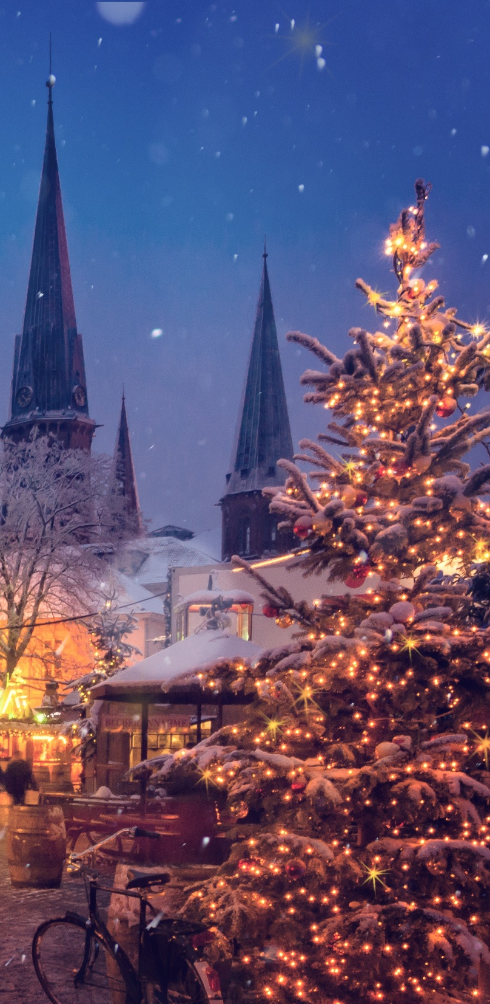
Christmas Around the World
Germany
According to legend, on Christmas Eve in Germany, rivers turn to wine, animals speak to each other, tree blossoms bear fruit, mountains open up to reveal precious gems and church bells can be heard ringing in the bottom of the sea. Only the pure of heart can witness the Christmas magic.
In many homes, children will be distracted while a Christmas tree is brought out and decorated on Christmas Eve. Presents are then put underneath. Traditionally, plates are laid out for each member of the family with fruit, nuts, chocolate and biscuits. Often, carols are then sung, sparklers are lit, the Christmas story is read and then the gifts are opened.

Slide 10
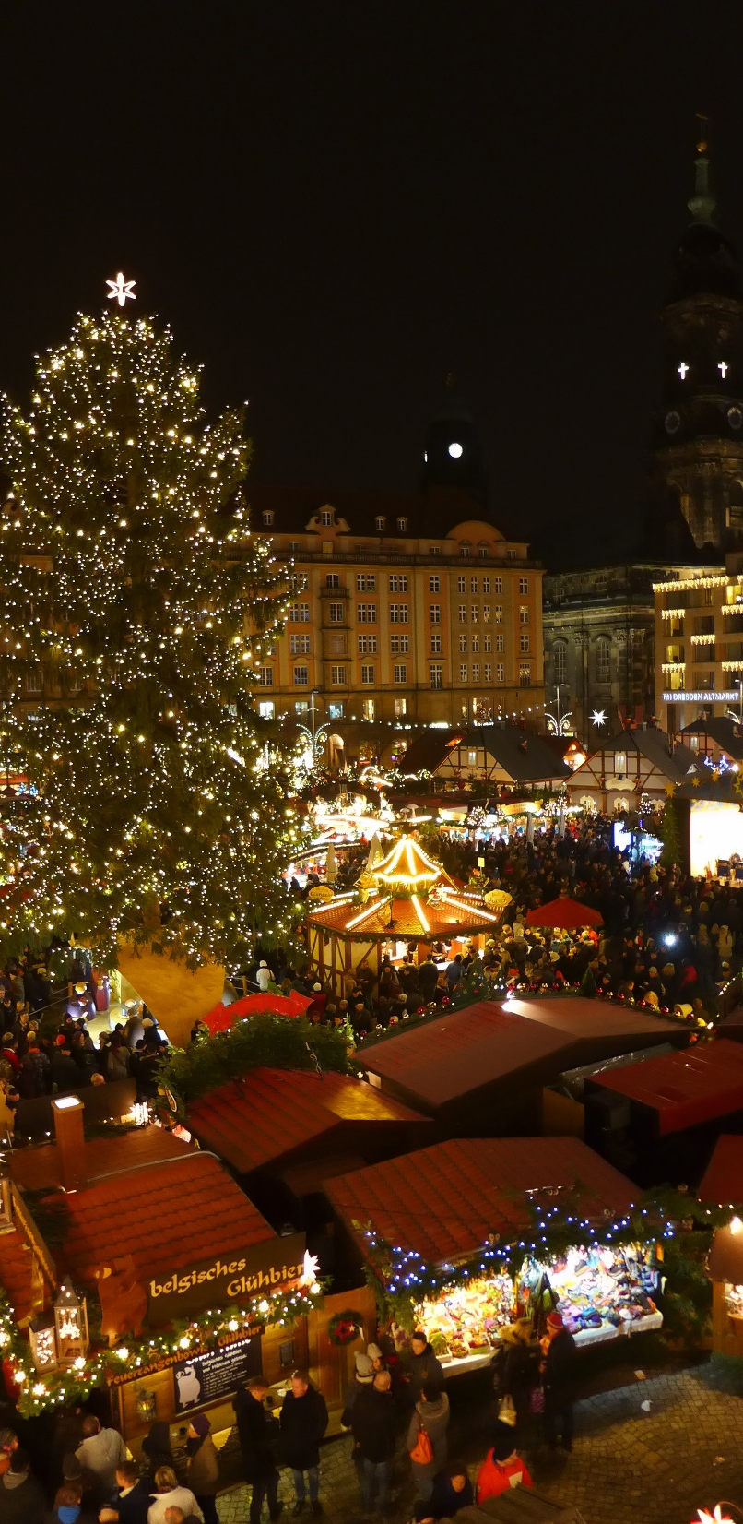
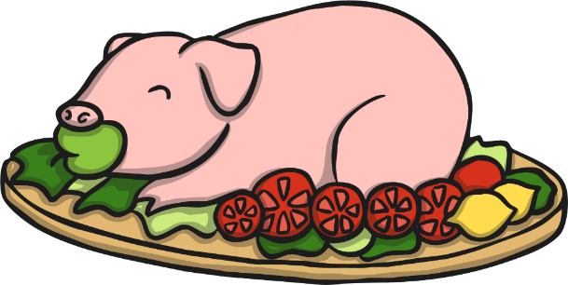
Christmas Around the World
Germany
On Christmas Day, many families enjoy a banquet of roast goose, breads and marzipan.
There are lots of huge Christmas fairs in Germany which are very beautiful.
After the presentation of the tree, there is a huge feast of dishes like suckling pig, white sausage, macaroni salad and many more.

Slide 11
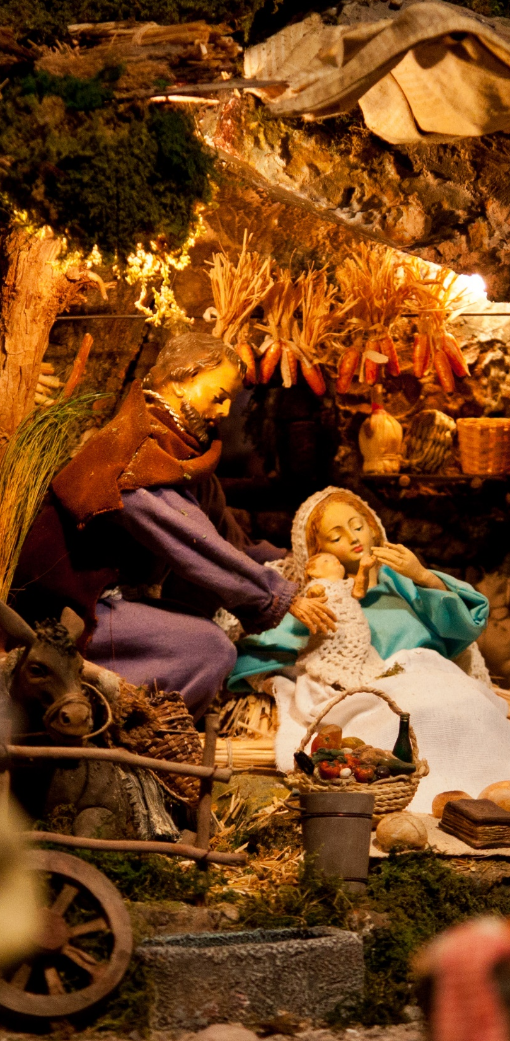
Christmas Around the World
Italy
The Christmas season is celebrated from early December until 6th January.
During the Christmas period, in some areas of Italy, shepherds come into the towns and play bagpipes and sing carols.
Most churches, town squares and houses will have a model of the nativity scene called a ‘presepe’. This is seen as the most important decoration at Christmas time.
In Italy, the traditional Christmas cake eaten is called a 'panettone’. It is a sweet cake filled with candied fruit.
“Presepe Piumazzo“ by Marcello is licensed under CC BY 2.0

Slide 12
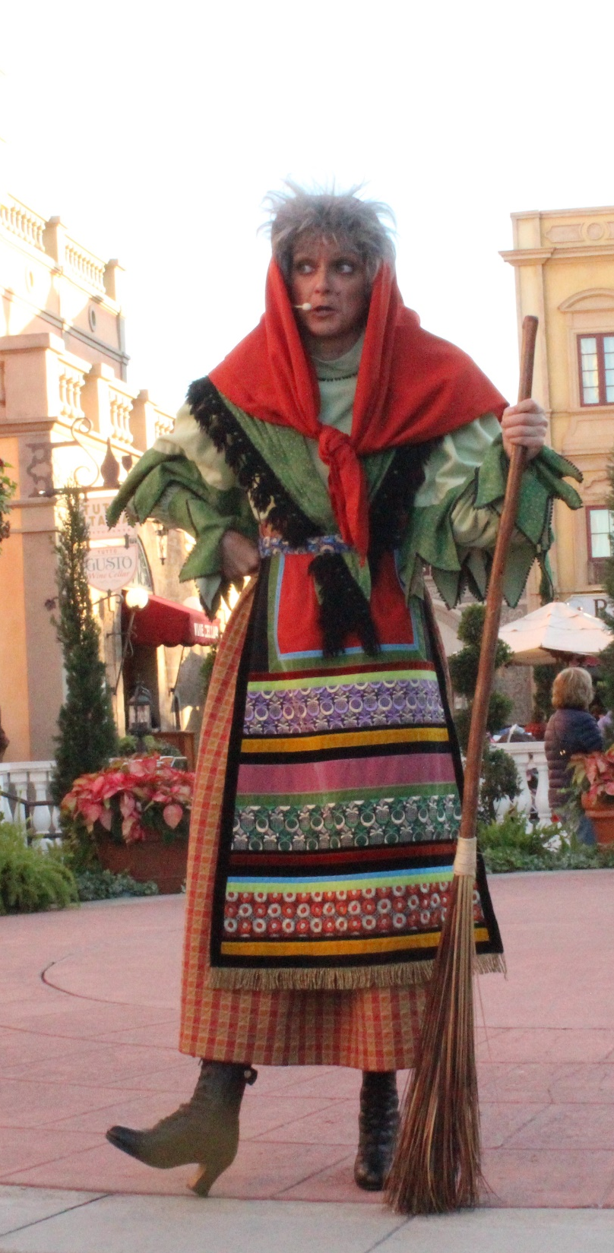
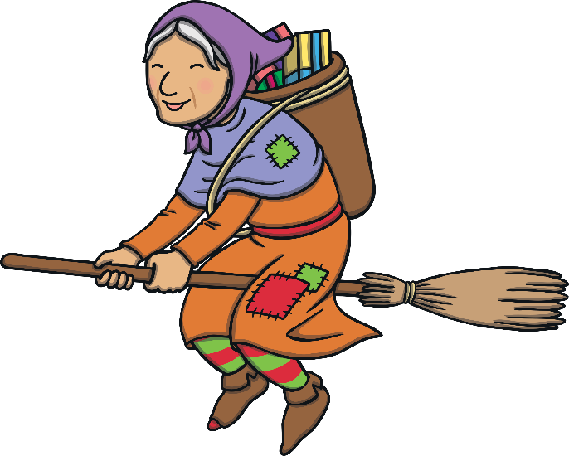
Christmas Around the World
Italy
In Italy, most children receive gifts on the 6th January. This day is called ‘Epiphany’. ‘La Befana’ traditionally brings presents.
Legend says ‘La Befana’ is an old, kind witch who flies on a broomstick. Long ago, the three wise men stopped to ask her for directions to the stable where the baby Jesus had been born. She didn’t know the way, but offered them shelter and food. They asked her to join them on their journey but she was too busy. Later that day she set off on her broomstick, with presents for the baby Jesus, to follow the wise men but could not find the baby. She is said to still be flying around, searching for the baby Jesus.
“Photo” by ThemeParkTourist is licensed under CC BY 2.0

Slide 13
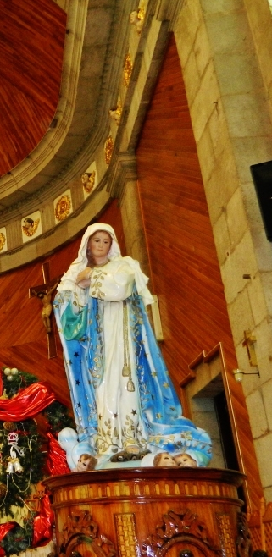
Christmas Around the World
Spain
In Spain, the main Christmas meal is usually eaten on Christmas Eve.
After everyone has eaten, at midnight on Christmas Eve, lots of people in Spain attend a midnight mass. This mass is called ‘The Mass of the Rooster’. It is called this because legend states that a rooster crowed the night that Jesus was born.
'The Day of Innocent Saints' is on 28th December. On this day, many people remember the innocent babies who were killed by King Herod as he searched for baby Jesus. Some people try to trick each other with pranks, similar to how others celebrate April Fools' Day.
Photo by Catedrales e Iglesias is licensed under CC BY 2.0

Slide 14
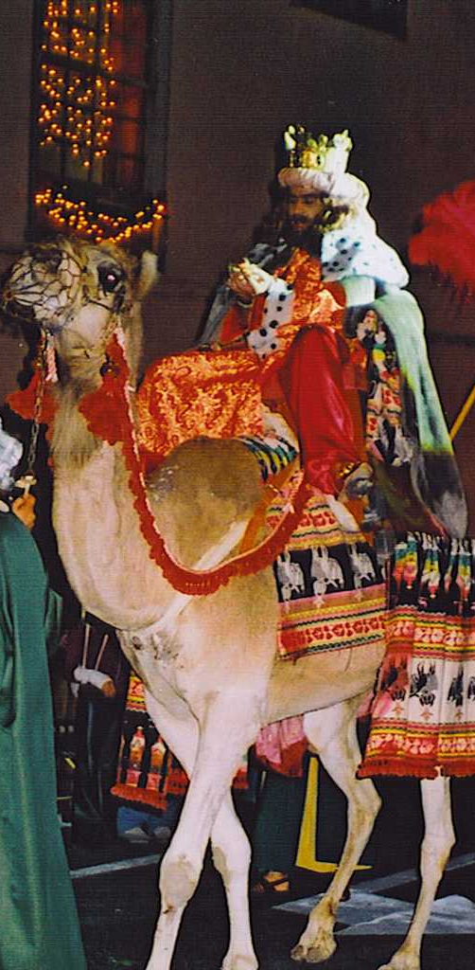
Christmas Around the World
Spain
On 6th January, Epiphany is celebrated in Spain. In Spain, this is called ‘The Festival of the Three Magic Kings’. This day celebrates the wise men bringing gifts to baby Jesus.
Usually, children in Spain receive a few gifts on Christmas Day but most on the 6th of January for Epiphany. Tradition says that the three kings travel around, continuing the tradition of giving gift, just like they did for baby Jesus.
On the night of the 5th of January, children leave their shoes out before they go to bed to be filled with gifts.
In large towns and cities, there are big Epiphany parades with floats, celebrating the three kings.
“Arrival of the King“ is licensed under CC BY 2.0

Slide 15
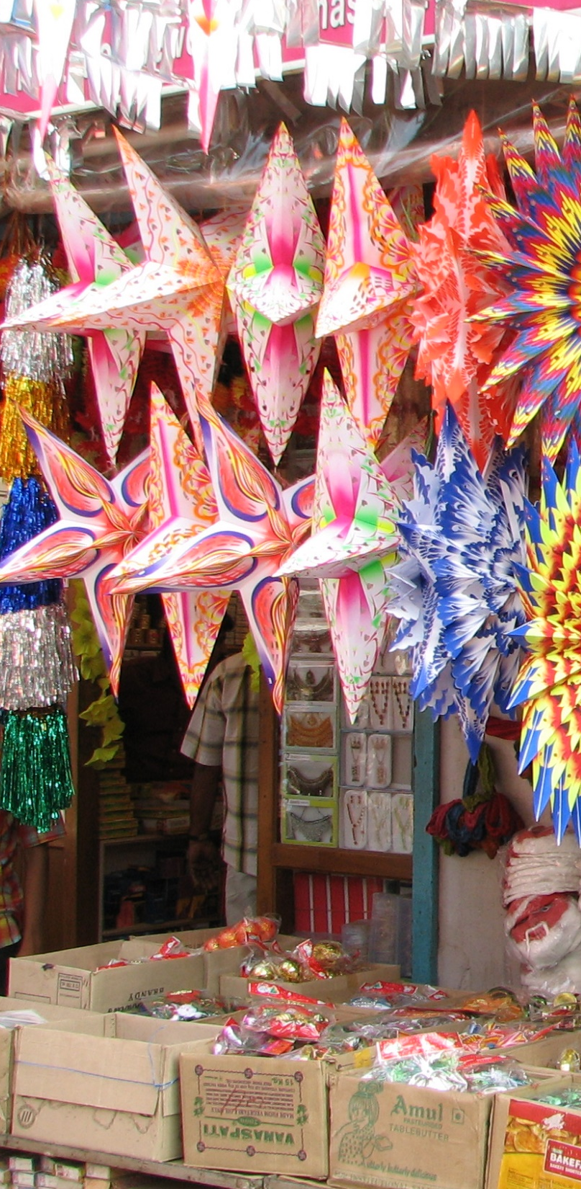
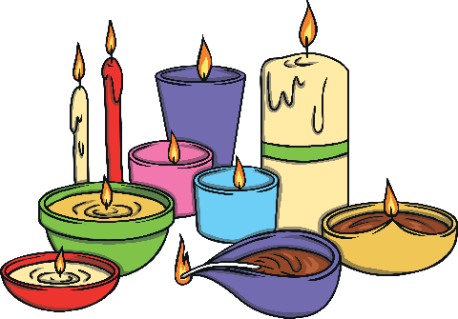
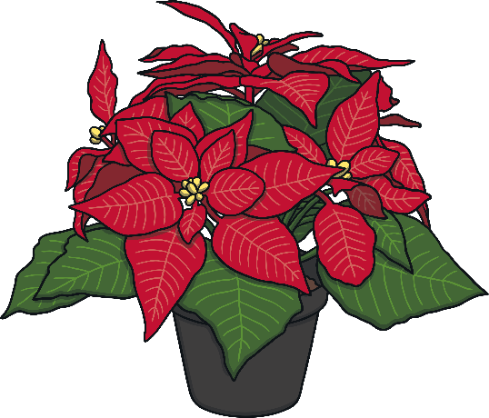
Christmas Around the World
India
Many Christians in India choose to decorate mango and banana trees at Christmas time.
Decorations are colourful and bright.
In some parts of India, small clay oil-burning lamps are used as Christmas decorations. They are placed on the edges of roofs and on the tops of walls.
Churches are decorated with poinsettias (red Christmas flowers) and candles for the Christmas Evening service.
“India – Kerala” by McKay Savage is licensed under CC BY 2.0

Slide 16
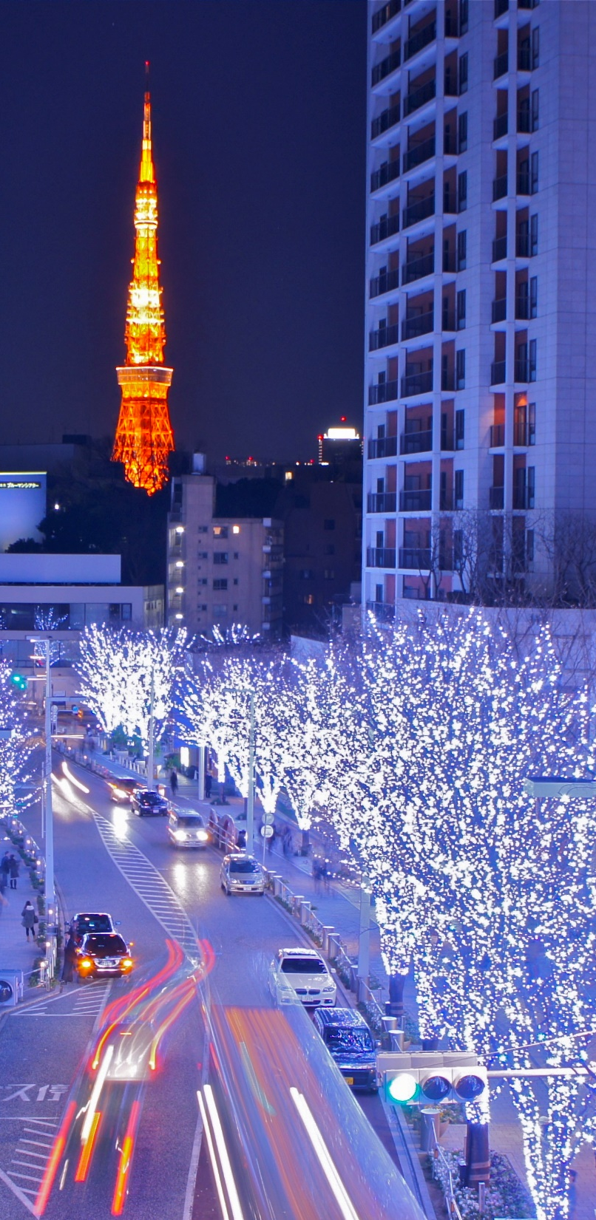

Christmas Around the World
Japan
Lots of people in Japan celebrate Christmas, although only 1% of the population is Christian.
Lots of homes are decorated with Christmas trees and mistletoe.
Lots of people in Japan enjoy exchanging gifts at Christmas.
“Tokyo Tower and Roppongi Christmas illumination” by Manish Prabhune is licensed under CC BY 2.0

Slide 17
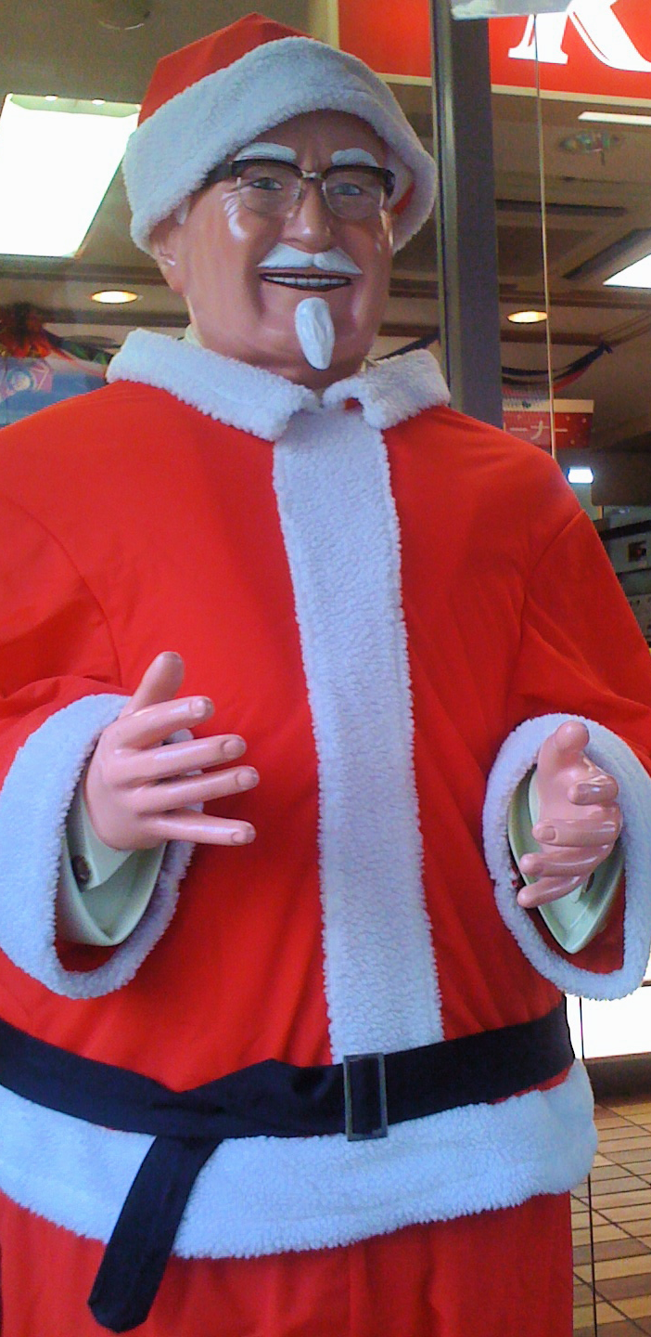
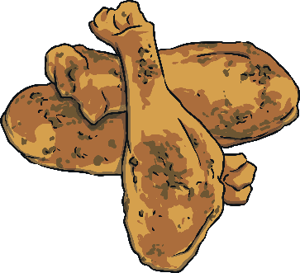
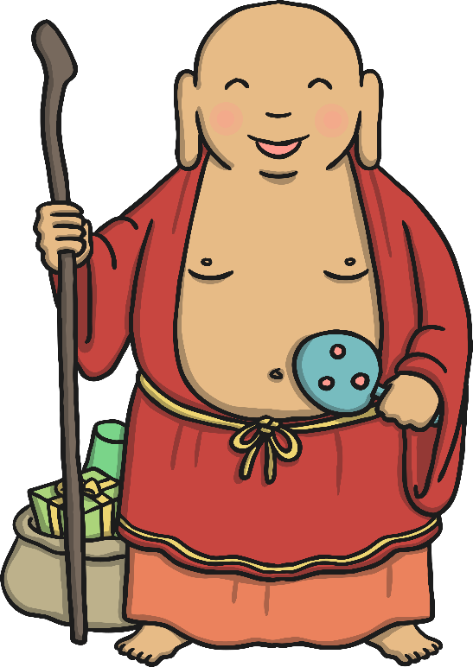
Christmas Around the World
Japan
On Christmas Day, many people in Japan eat fried chicken for dinner! Local fast food restaurants can be fully booked months in advance.
A Buddhist monk named Hotei-osho acts like Santa Claus. He brings presents to each house for children. Some think he has eyes in the back of his head so that children behave when he is nearby.
“Colonel Sanders Santa” is licensed under CC BY 2.0

Slide 18
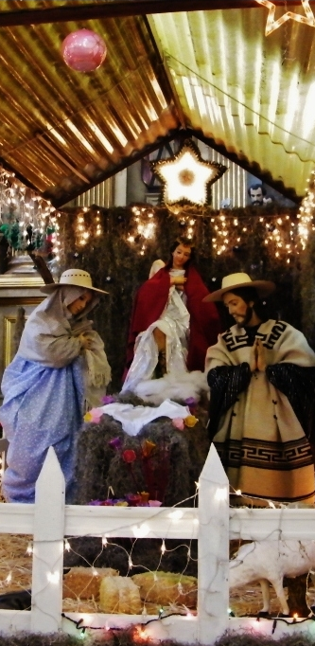
Christmas Around the World
Mexico
Several weeks before Christmas, there are huge markets set up in towns and cities in Mexico which offer crafts, food and flowers for the Christmas season. Some people travel for days to get to these markets.
The poinsettia is a red flower native to Mexico that is used widely in Mexico as a Christmas decoration. It has been connected with Christmas since the 17th century.
“Parroquia San Pablo Apóstol,Cuauhtémoc,Ciudad de México” is licensed under CC BY 2.0

Slide 19
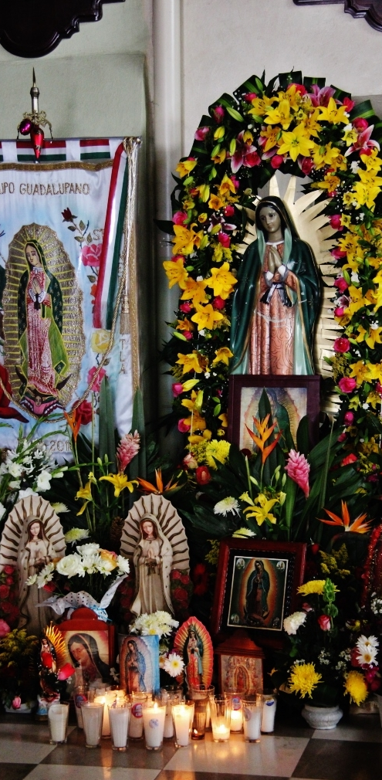
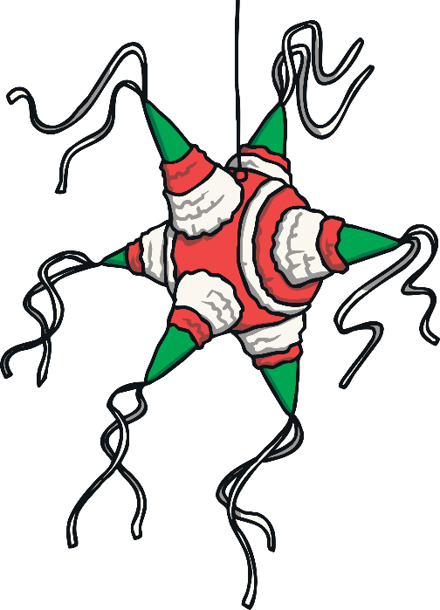
Christmas Around the World
Mexico
The main Christmas celebration in Mexico is called Las Posadas. People re-enact Joseph and Mary’s search for somewhere to stay in Bethlehem. They go house to house getting refused until they finally reach a house where an altar and nativity scene have been set up.
Once they have reached the right house, a traditional prayer is spoken and the party begins. Food and drink are served and then children take it in turns to break open the piñata.
“Templo Santa María Nenetzintla,Acajete,Estado de Puebla,México” is licensed under CC BY 2.0

Slide 20
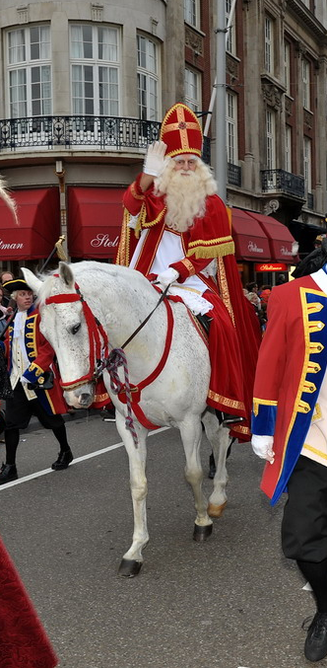
Christmas Around the World
Netherlands
In the Netherlands, Santa Claus is known as ‘Sinterklaas’.
Sinterklaas arrives three weeks before the 5th December on a steamboat
from Spain, accompanied by 100 Zwarte Pieten.
The Zwarte Pieten are full of mischief and hand out lots of sweet treats,
called perpernoten.
Between his arrival and the 5th December, many children fill their shoes
with hay and sugar for Sinterklaas’s horse and awake to find them filled with little presents or nuts and candy.
“Sinterklaas” is licensed under CC BY 2.0

Slide 21
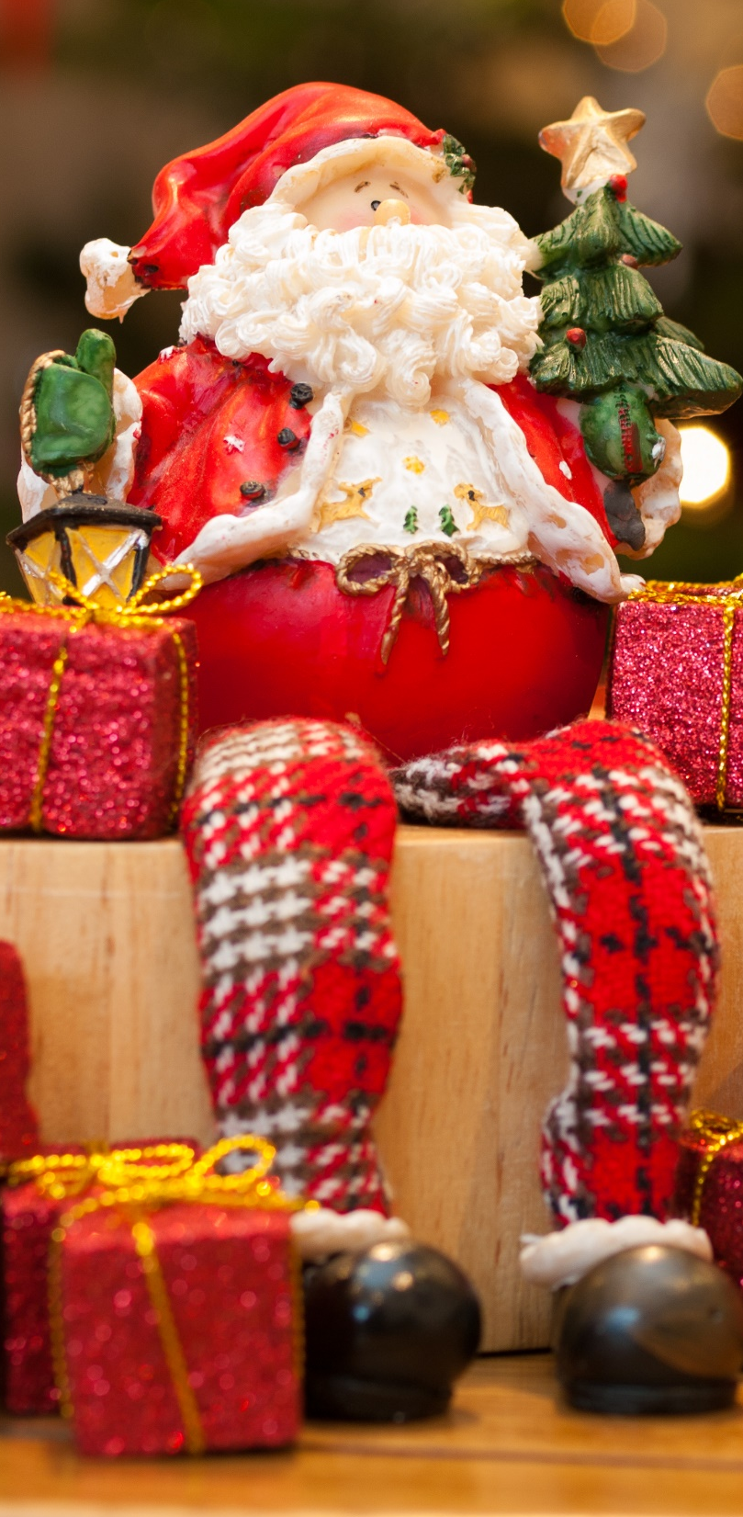
Christmas Around the World
Netherlands
On the 4th December, Sinterklaas appears in person in children's homes asking the children about their behaviour over the past year.
On the evening of the 5th of December, the Zwarte Pieten ring the doorbell and leave big bags of presents before running off. Sometimes, Sinterklass will visit the houses too to talk to the children.
People in the Netherlands also celebrate Christmas from 24th-26th December.
Sometimes, there is a 'Sunday School' service in church where the Christmas Story is read.
On Christmas Eve, Many children in the Netherlands believe Santa delivers more presents from Lapland!
Photo by William Warby is licensed under CC BY 2.0

Slide 22
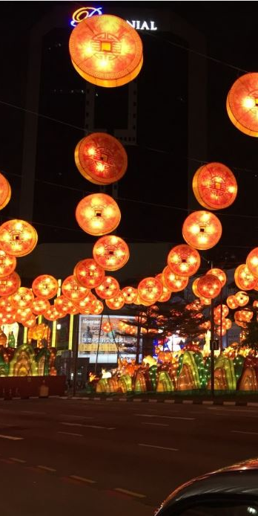
Vietnam
Christmas Around the World
In Vietnam, Christmas Eve is often more important than Christmas Day.
In Ho Chi Minh City, many people like to go into the city on Christmas Eve to visit a Catholic Cathedral.
Many people will celebrate Christmas by enjoying Christmas decorations and lights in big department stores and hotels across the city. They may also throw confetti and take pictures.
All churches and some Christian homes will display a nativity scene.
At Christmas, some Vietnamese people will share a special Christmas Eve meal called ‘reveillon’ followed by a chocolate log
for desert.

Slide 23

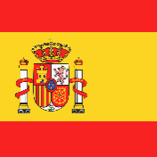
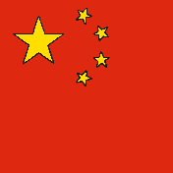


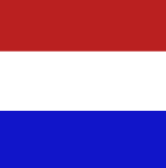



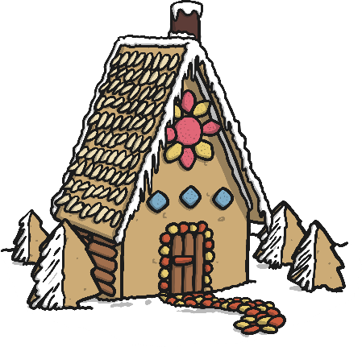
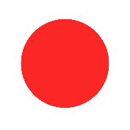

Christmas Around the World
English
Spanish
Mandarin
Merry Christmas
Feliz Navidad
Shèng dàn kuài lè
Vietnam
French
Dutch
Giáng sinh vui vẻ
Joyeux Noel
Vrolijk Kerstfeest
Italian
German
Buon Natale
Fröhliche Weihnachten
Japanese
Merii Kurisumasu

