Slide 1
Teaching Spelling in KS1 at Windy Nook
In school we want our children to become confident spellers who are resilient enough to have a go at unfamiliar words using a variety of strategies. Spelling is part of our daily English lesson and is reinforced in other subjects including Maths. Phonics lessons are also part of the school day in KS1 with some children joining extra interventions to boost their learning.
The support you give your child to embed these strategies is crucial. The following slides offer information about spelling in Year 1 and 2 with ideas to support this learning.

Slide 2
Children who struggle with spelling usually have no strategies up their sleeve when they get stuck on a word. Ask any weak spellers the question, ‘what do you do when you cannot spell a word’. They will have, at best, one strategy. But it is most likely that they guess. To help them become better spellers they need to acquire a range of different approaches to help them. Pie Corbett

Slide 3
What makes a good speller?
Good visible memory Positive attitude
Recognise rhyme and rhythm Perseverance
Distinguish sounds around them Syllables
Oral blending and segmenting Hold a pencil
Observe order of events Recognise parts of a whole Rules/conventions/strategies Recognising Patterns
Exceptions/tricky words Alphabet – sounds and names
Link letters with sounds Prefixes/suffixes
Inflected endings RWI Phonics

Slide 4
Good Spellers Apply:
Phonics
Words within words
Grammatical knowledge
Memory and experience
Existing knowledge
Synonyms

Slide 5
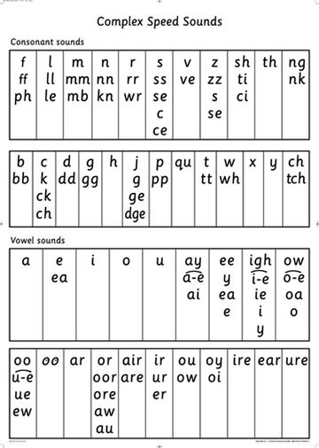
Children need to be able to use phonics to spell accurately.

Slide 6
Year 1 common exception words
Year 2 common exception words
door, floor, poor, because, find, kind, mind, behind, child, children, wild, climb, most, only, both, old, cold, gold, hold, told, every, everybody, even, great, break, steak, pretty, beautiful, after, fast, last, past, father, class, grass, pass, plant, path, bath, hour, move, prove, improve, sure, sugar, eye, could, should, would, who, whole, any, many, clothes, busy, people, water, again, half, money, Mr, Mrs, parents, Christmas
the, a, do, to, today, of, said, says, are, were, was, is, his, has, I, you, your, they, be, he, me, she, we, no, go, so, by, my, here, there, where, love, come, some, one, once, ask, friend, school, put, push, pull, full, house, our
Learning how to read and spell these words helps children with their pace and confidence in writing.

Slide 7


There are lots of strategies that can be used to teach children to spell. They don’t have to always depend on sitting down with paper and pen. The more creative the better.
Use chalk to write the word on the pavement
How many times can you write the word in 1 minute? Can you beat your score?
Chunk the word into smaller parts.
Look, say, trace, cover, write check.
Mnemonics- said (sausages and insects dance
Think of other words with the same pattern- night, fight, right…
Say it as you spell it- pe-o-ple
Look at the word shape. Does it look right?
Underline the tricky part.
Find smaller words inside the word. Eg. Teacher- each, ache, tea, her
Use a different colour to highlight the tricky part of the word.
Use different materials: paint, clay, sandpaper, play dough, felt tips…
Look at the word and practise visualising it (see it behind your eyes)

Slide 8


For longer words- write the word and cut it into syllables. Put it back together in the correct order.
Play hangman
Write it in different letters such as bubble writing.
Cursive handwriting helps children to connect letters within words.
Record your own voice spelling and saying the word.
Teach it to somebody else.
Write it in different colours on sticky notes and put them where you can see them.
Rainbow spellings- write the word and overwrite it using a different colour each time.
Write the words and highlight the vowels in red pencil.
Triangle spellings.
k
ki
kin
kind
Use scrabble letters. Take turns to take a letter out of a bag until you can spell the word with the letters.
Make a picture
eye

Slide 9
Some words lend themselves better to particular strategies:
Big Elephants Can Always Understand Small Elephants = Because
You wouldn’t want to FRI the END of your friend! = Friend
We went TO GET HER = Together

Slide 10
Other strategies:
Compound words
grand + mother = grandmother
Every + where = everywhere
Some + thing = something
Words within words
hear when there

Slide 11
What can you do to help ?
Spend some time helping – little and often is best
Play games – make it as fun and enjoyable as possible
Lots of encouragement and praise!

Slide 12
Some useful websites:
https://spellingframe.co.uk/
http://funschool.kaboose.com/globe-rider/explorer-adventures/games/game_atonra_the_lost_statue.html
http://www.kidsspell.com/
http://www.crickweb.co.uk/ks2literacy.html
http://www.bbc.co.uk/schools/wordsandpictures/longvow/poems/fpoem.shtml http://www.funbrain.com/kidscenter.htm l http://www.bbc.co.uk/schools/spellits/
http://www.parentsintouch.co.uk/Spelling-worksheets

