Slide 1
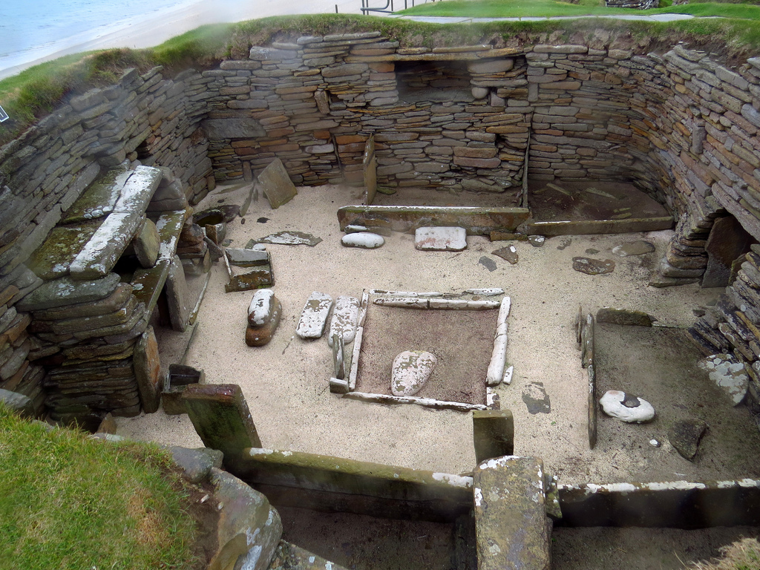
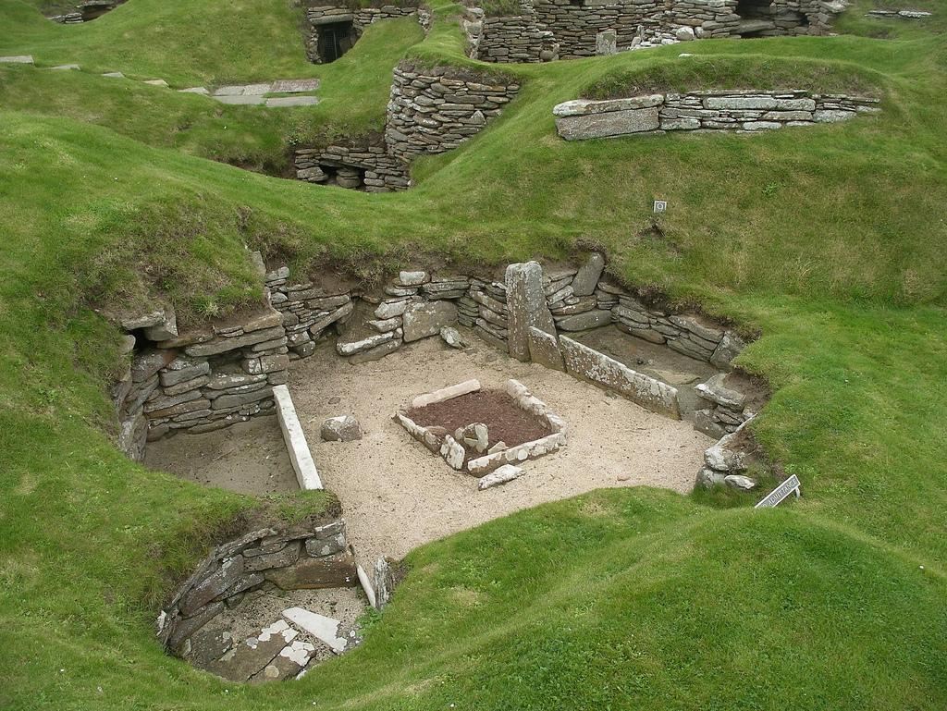
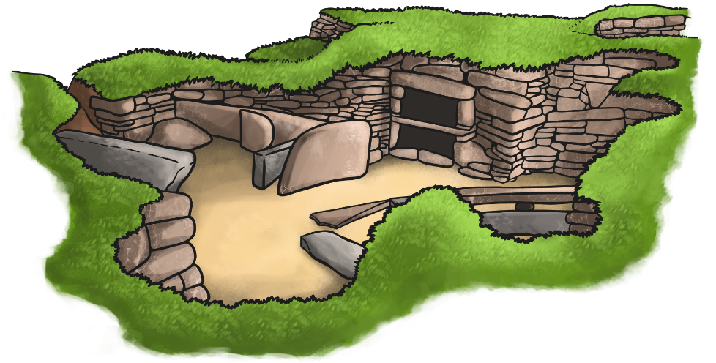
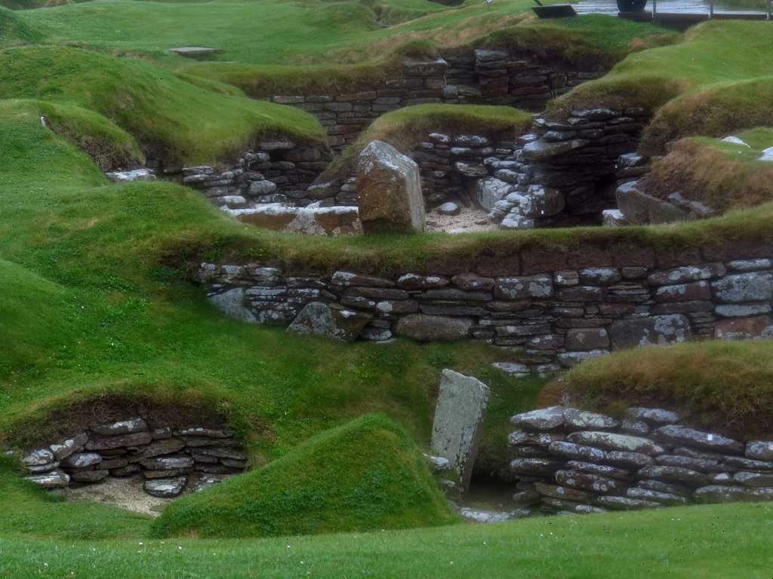
Skara Brae

Slide 2
The Houses
Remains of eight houses still stand on the site but they were not all built at the same time which means that the original village has been added to. Apart from one house, the houses are all linked together by covered passageways. The earlier houses are in a circular shape but then later houses that got built were more rectangular. In a house, there was one main room with a fire pit in the centre. The beds were built in to the walls at the sides.The walls of the houses were built against midden which is piles of discarded rubbish.

Slide 3
Light, space and warmth
There were no windows in the houses but there might have been a smoke hole built into the roof.They had a fire so there would have been some light from that although wood was scarce in the Orkney Islands so they had to use burnt seaweed, dried animal dung and peat. They made mattresses out of heather and straw and would have likely used animal skins for their blankets. It would have been quite cosy compared to outside at least!

Slide 4
Houses 7&8
House seven looks exactly like the other houses there at first glance but really it is quite different from the rest. An interesting fact about house seven is that the bodies of two women were found in a stone grave underneath a wall but the house was built on top of them. This could have been part of some ritual.

Slide 5
What else was found there?

