Slide 1
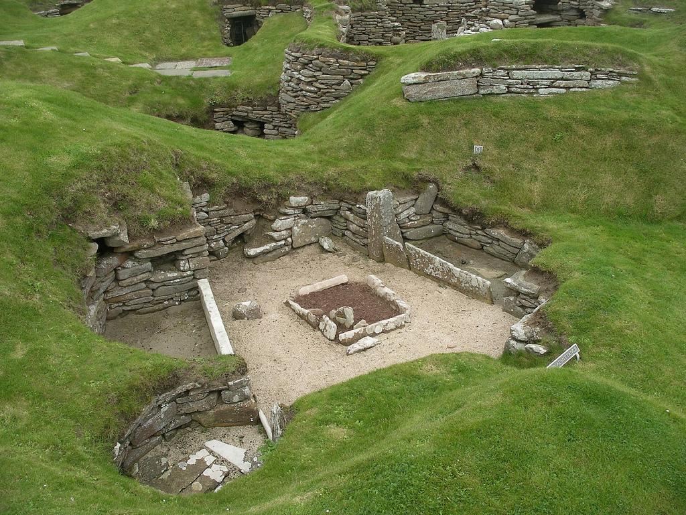
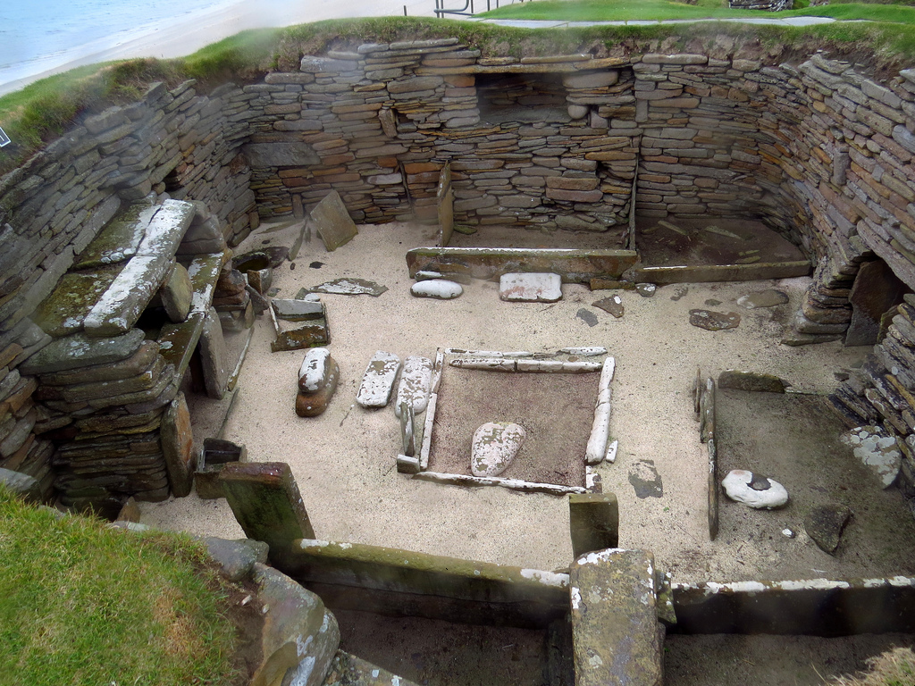
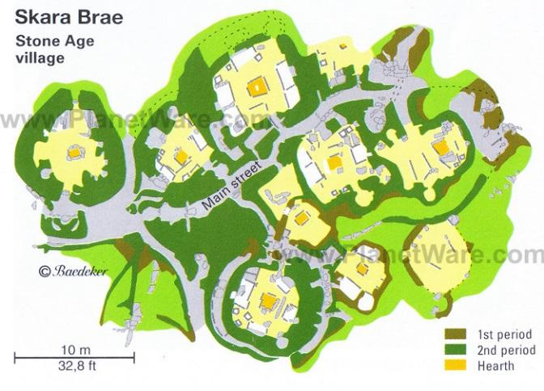
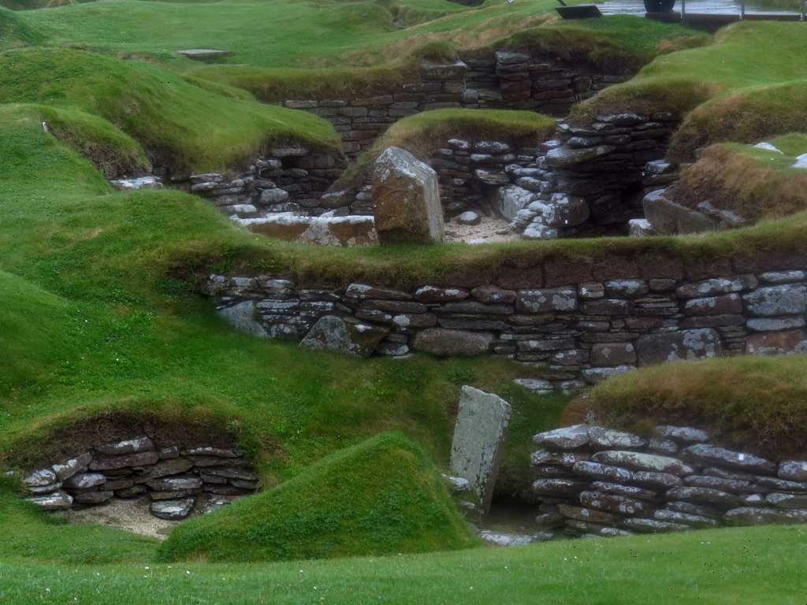
Skara Brae

Slide 2
The Houses
Skara Brae is located on the Orkney islands off the North coast of Scotland. It can be found on Mainland, the biggest of the nineteen islands.
The remains of eight islands stand on the site. They weren’t all built at the same time so the later houses are slightly different to the early ones. Earlier houses were more circular whereas the others were rectangular but they had rounded corners.
The houses contained a set of stone shelves, called a dresser, dug-in stone beds (later houses had beds that were not dug in the wall) and a fire pit. The houses were linked together by passageways and each house had a door made of slabs which could be bolted shut.

Slide 3
House Seven and House Eight
House Seven and House Eight are slightly different to the rest of the houses so it’s worth knowing about them.
The bodies of two women were found under House Seven. They were buried before the house was built and this may have been part of a ritual. The door of House Seven could only be bolted from the outside. Those who were inside would not be able to leave of their own free will. Unlike the other passageways, the passage that led to House Seven only went to House Seven.
Unlike the other houses, House Eight stands alone. It has no furniture or beds or passageways linking it to the other houses.

Slide 4
Light, Space and Warmth

Slide 5
What else was found there?

