Slide 1
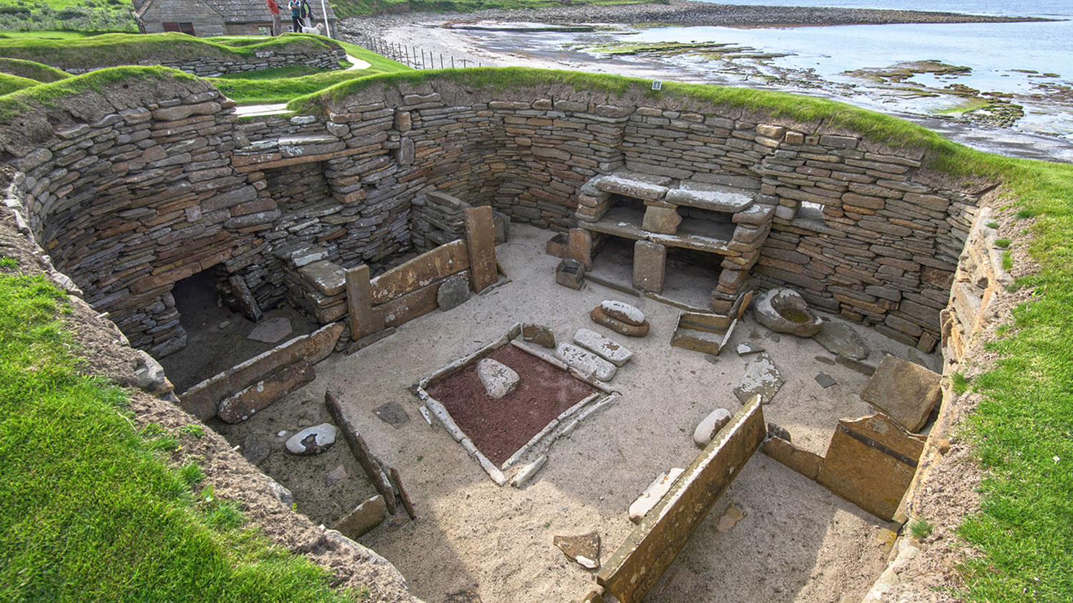
Introduction
Skara Brae is a stone age village discovered in 1850. It was found on Orkney Islands off the north of
Scotland. Most archeologists say it was made in the Neolithic time (New stone age).It was found because of a storm that made it visible.
SKARA BRAE FANTASTIC FACTS

Slide 2
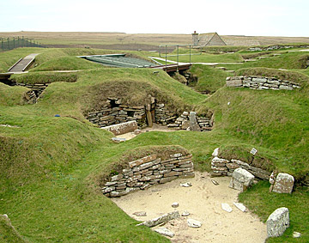
The houses
Altogether there is 8 houses on the site. The stone age people built the corners round.People from the stone age time slept on stone beds.All the houses were built different times. There was one main room that had a fireplace.

Slide 3
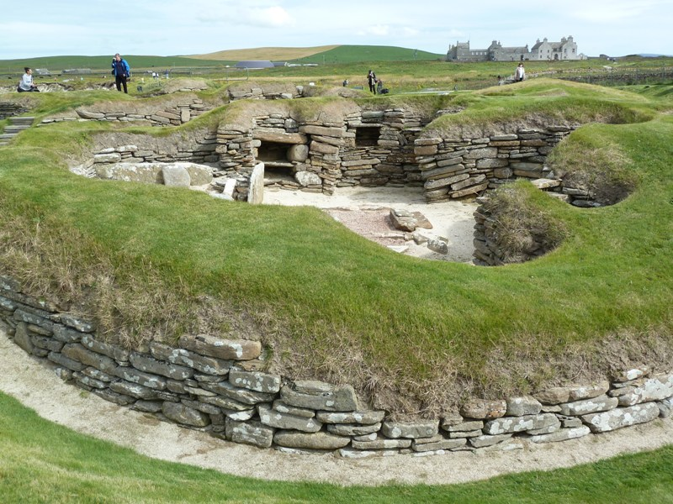
House 7
House 7 had 2 graves of 2 women under a wall.Also there was only one passage in house 7 and only lead to house 7.Interestingly the door could only be opened from the outside.This made people think slaves were kept in there.

Slide 4
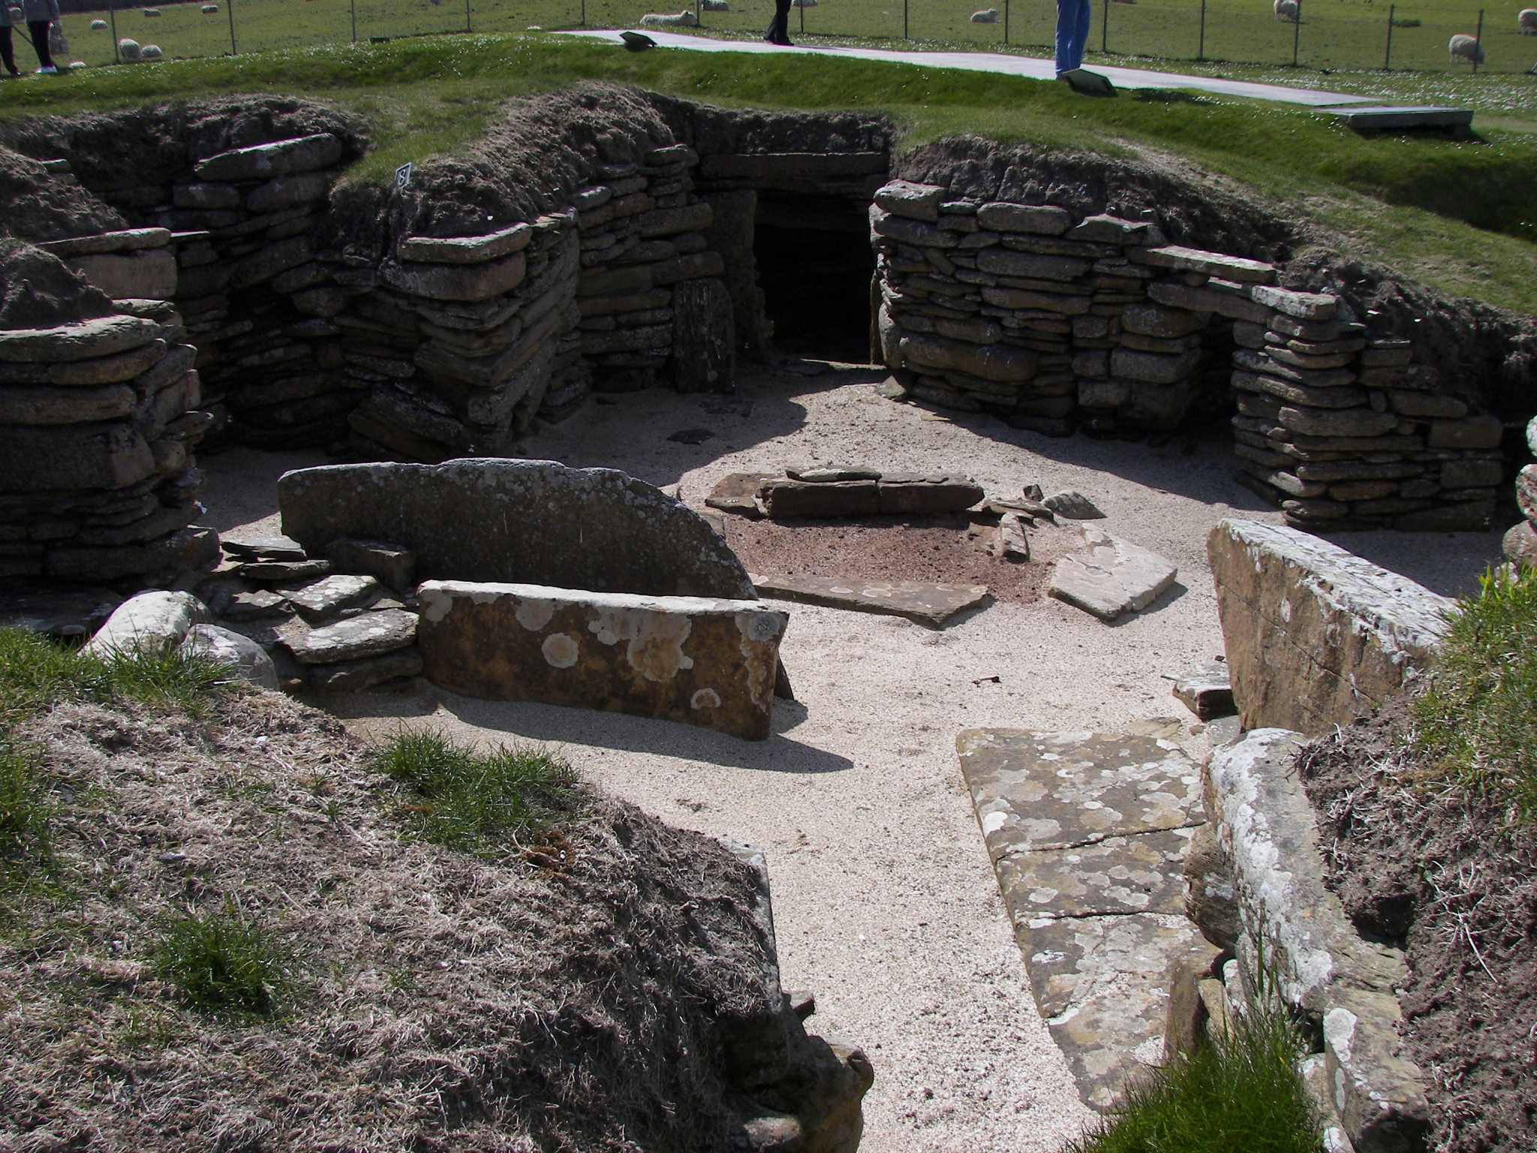
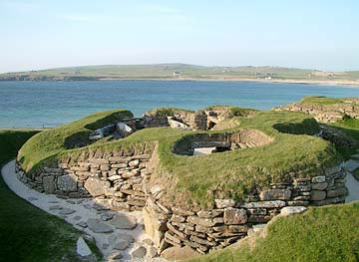
House 8
In house 8 there were no beds or shelves.This made people think it was a workplace.House 8 had patterns on all over the walls.Also house 8 is the only one that stands alone.
.

Slide 5
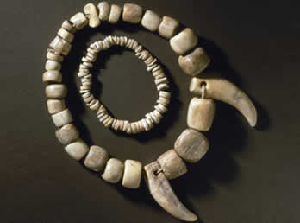
Other interesting facts
Because the lack of weapons people suggested it was peaceful back then.In all the houses you might of realized the houses had no windows.Many examples of jewelry was found.None of the houses had roofs made of stone or brick but perhaps they used moss.
.

