Slide 1
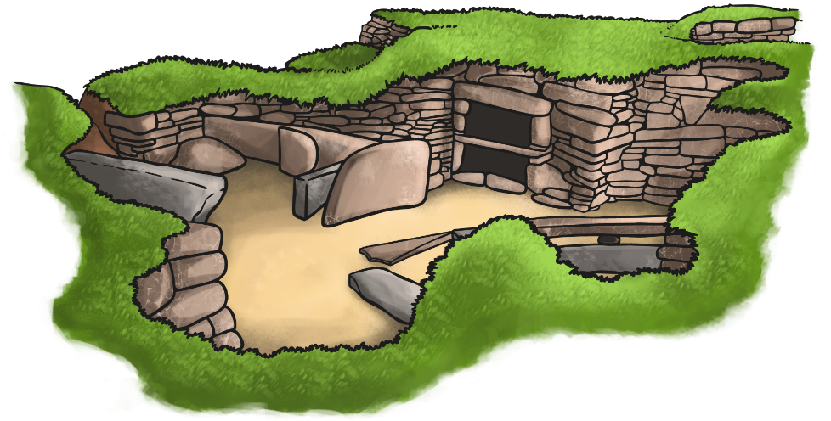
Skara Brae

Slide 2
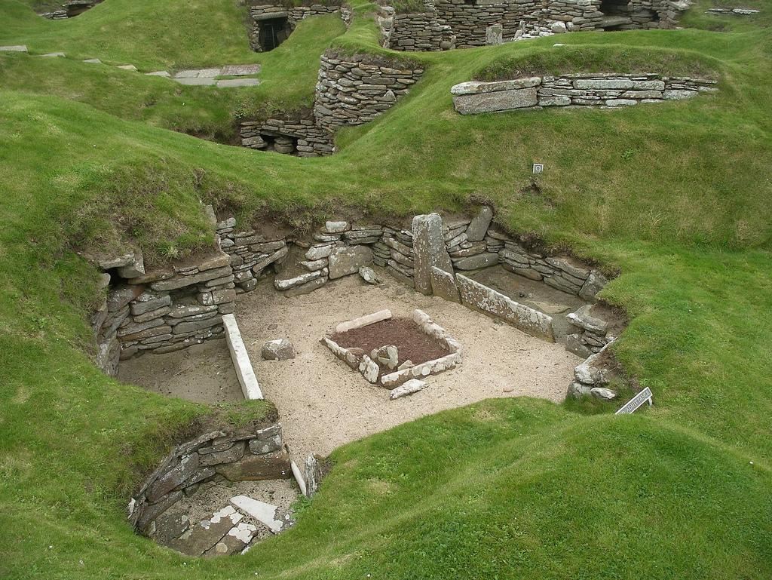
Introduction
The Skara Brae is very well preserved. This was made in the Neolithic period (newest stone age). It was found in 1850 in the north of Scotland. It was on the Orkney Island on the Mainland. These beautiful stone houses were built in 3000 BC. The way it was found was that a huge storm took away the land and showed this amazing masterpiece.

Slide 3
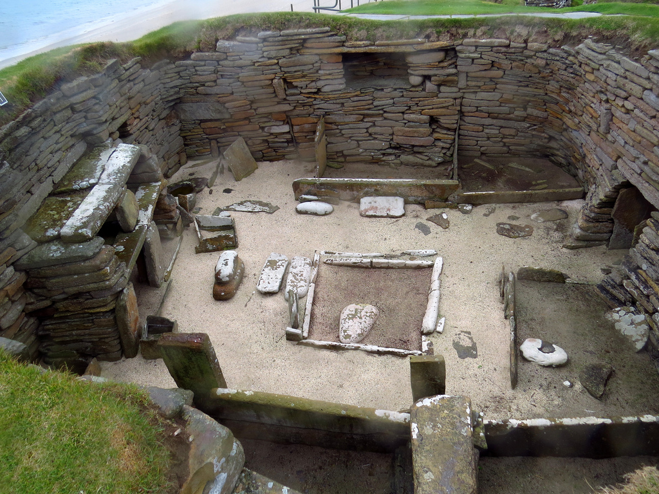
Houses
There are remains of eight houses. We have figured out that all the houses were not built at the same time. This is because the early houses were more circular than the later houses. All the houses were linked together by hallways. This suggests that they did not get much privacy wherever they were. There is actually one room with a fire pit in the middle. The beds were built in the walls so it must of been really uncomfortable.

Slide 4
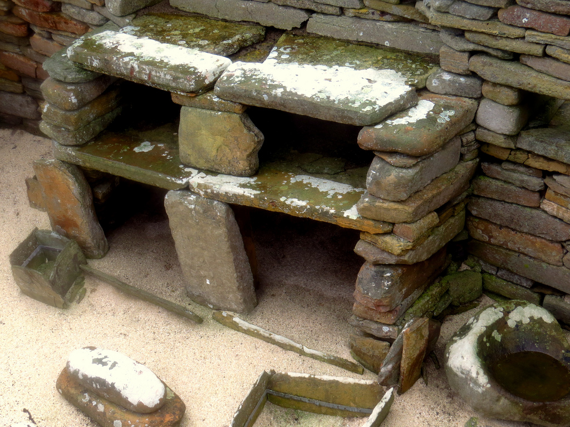
Layout
This is about later on in the Skara Brae. Every house has a dresser. The later houses were more rectangular than circular. Now the beds were built out of the wall so it might be a bit more comfortable. The fire pits were still in all of the houses. The doorways were smaller because the weather was really wet and rainy. This is due to the location of the houses. The doors were made out of stone slabs. The size of the houses were about 36m2 or 40m2. There were no windows so if it gets hot they will have to sit on the cliff edge since they are on the coast of Scotland.

Slide 5
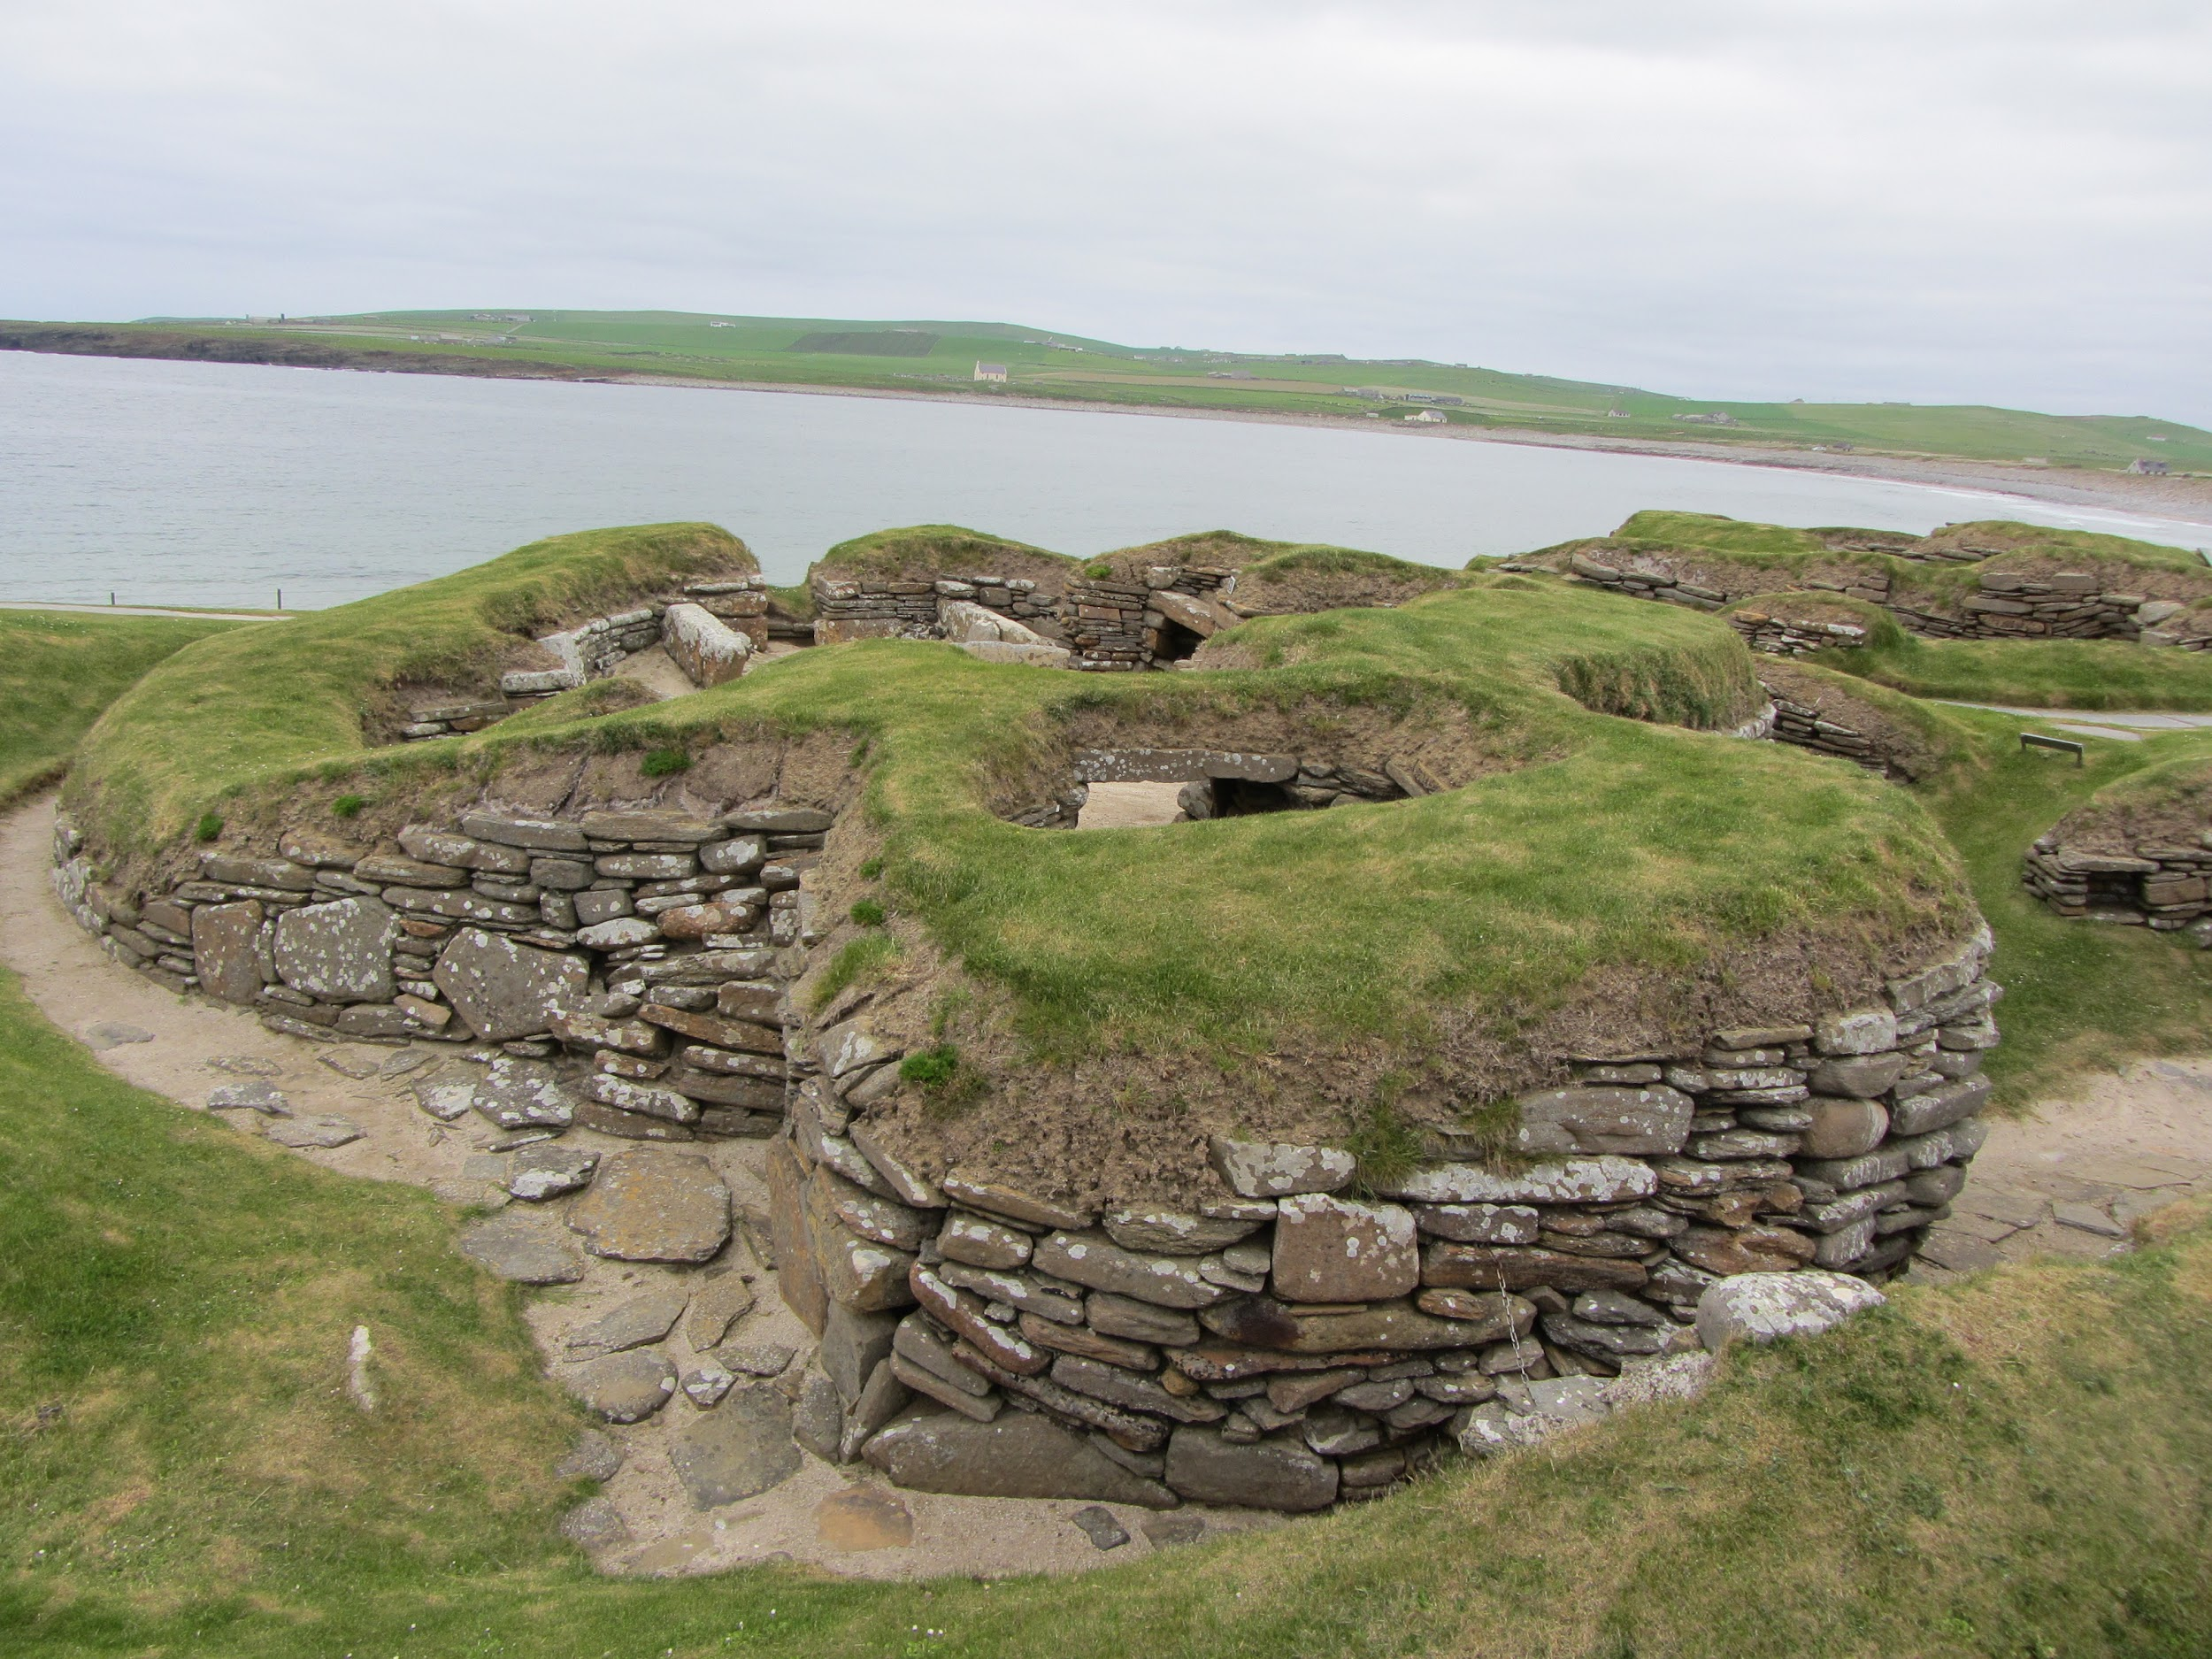
House 7
There is something really interesting about this house. Two women were found in graves under one of the walls. No one knows why this is but there was something else weird. There were bolts on the doors but they were on the outside so whoever was in that room was trapped. The women were found in graves so they must have been buried by someone.

Slide 6
House 8
Unlike other houses, all built closely together and linked with passageways, house 8 was on its own and had weird patterns on the walls. It also had no beds or drawers. I think it could have been a church or a meeting place for jobs. The floor was found covered in pieces of material used in the manufacture of tools.

