Slide 1
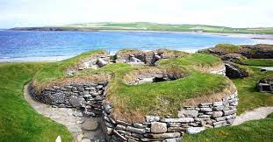
Skara Brae
Notes:
Introduction
The Skara brae are some very famous yet old runes from many years ago.These runes may look normal but really 2 have a dark side.

Slide 2
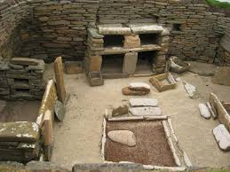
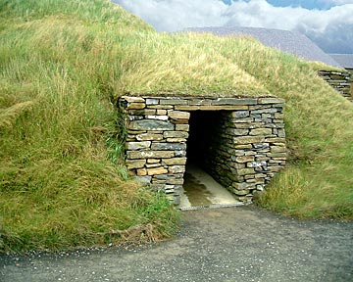
The houses
Notes:
6 of the houses are normal but 7 and 8 are different.The normal houses had rock beds and sets of stones called a dresser.

Slide 3
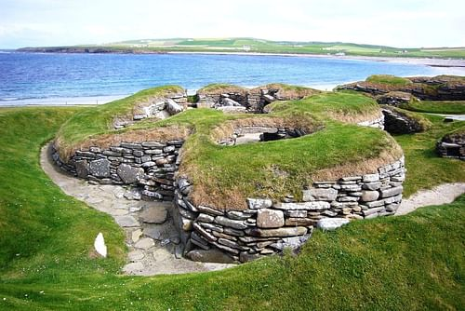
House 8
Notes:
House 8 is different it has no beds and no dresser.The door can only be bolted shut from the outside and it stands further away from the others.The wallpaper has patterns carved everywhere.

Slide 4
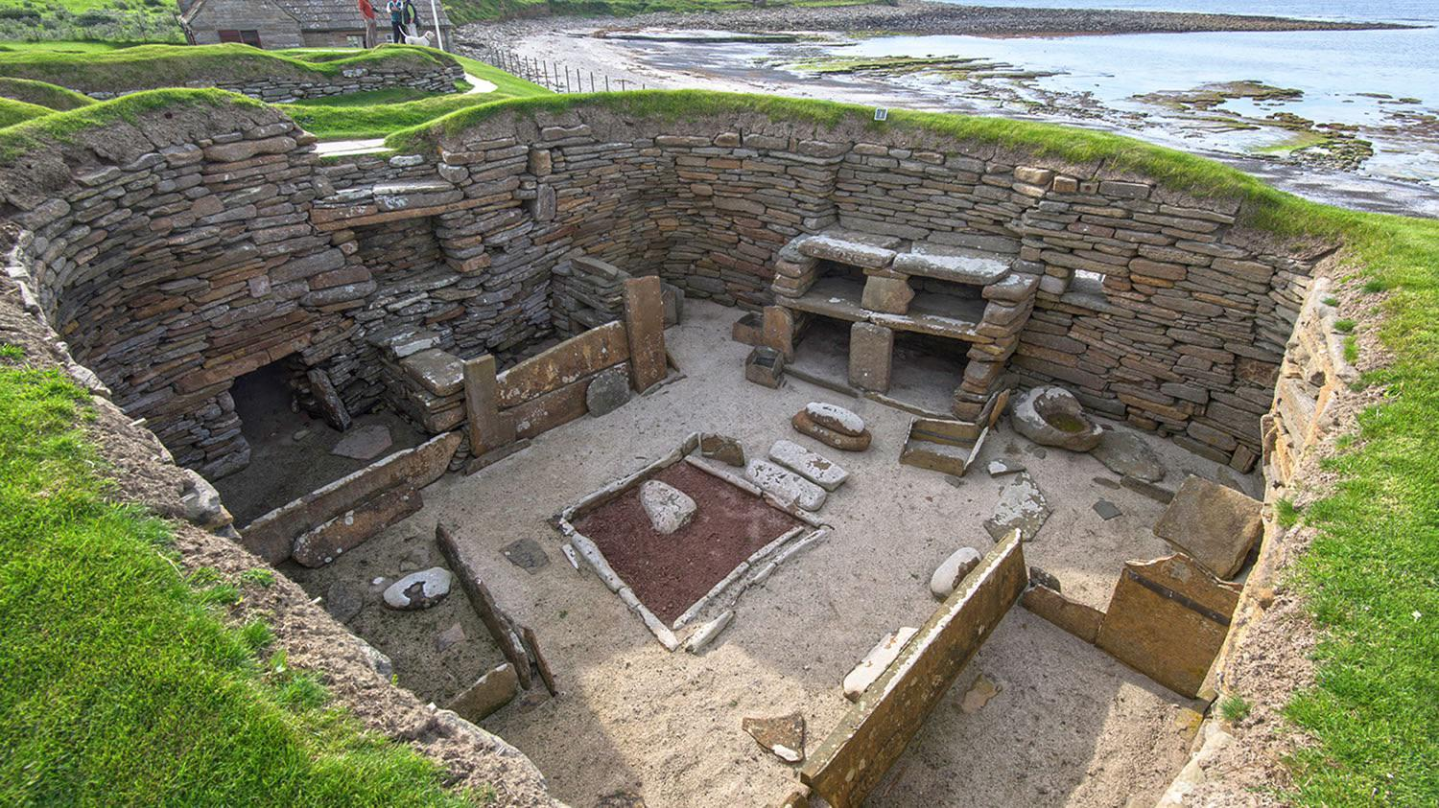
House 7
Notes:
House 7 looks boring and normal but really it is not.House 7 is believed to be used for rituals because there were two womans bodies were found under the walls.

Slide 5
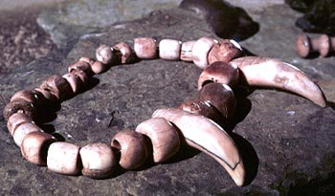
Interesting Facts
Notes:
There was old jewlery found in the area.The shelfs were made out of stone and made carefully.They used animal skin alot.There were fishermen and farmers

