Slide 1
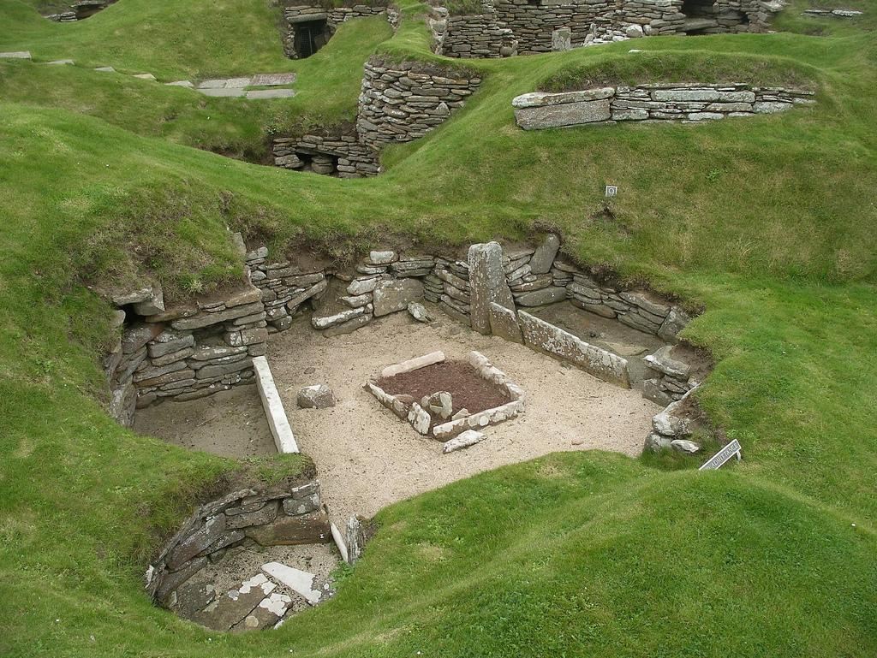
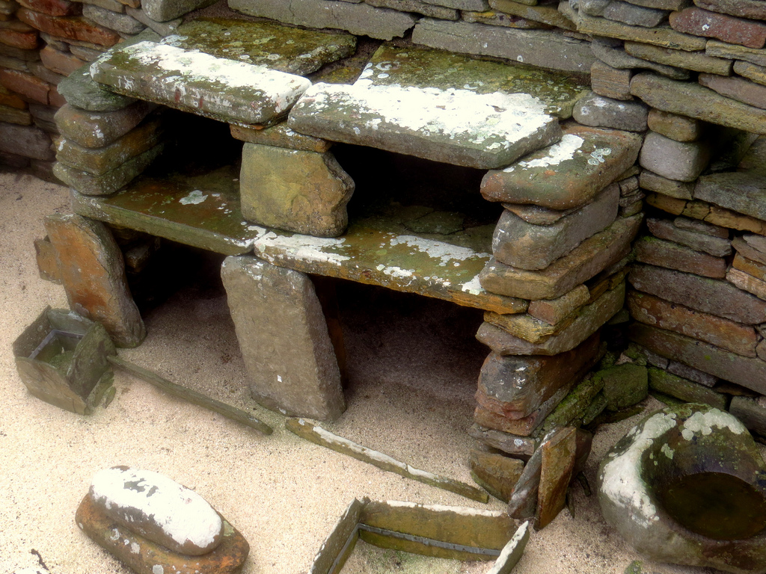
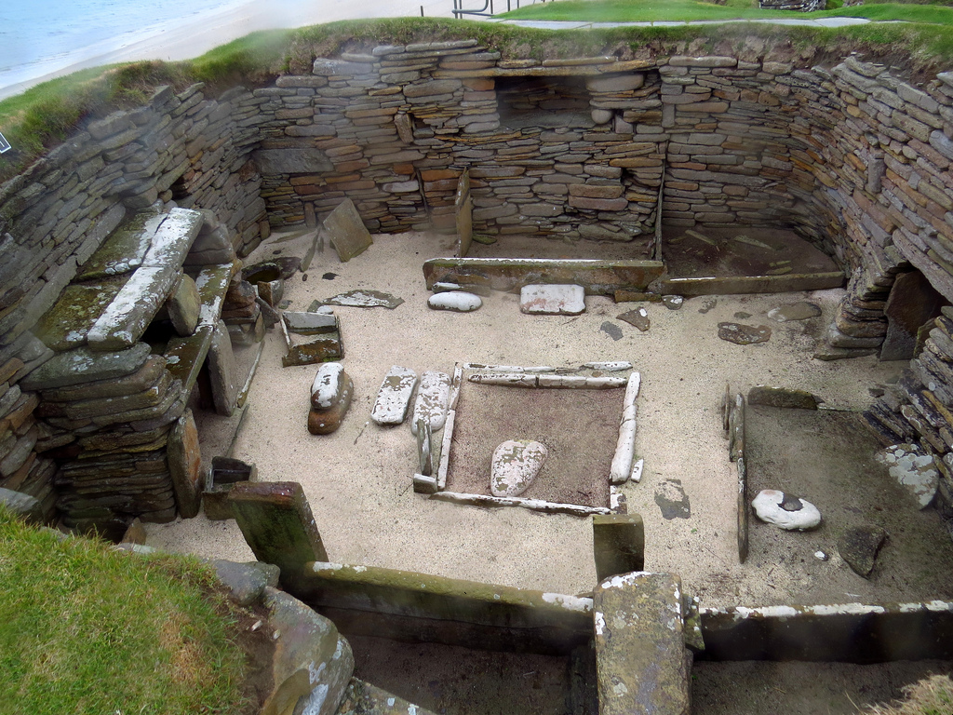
Skara Brae
Skara Brae was discovered in 1850 after a massive storm stripped it away.It was built around 3000 BC in the Neolithic period. It’s a stone age village made out of stone.

Slide 2
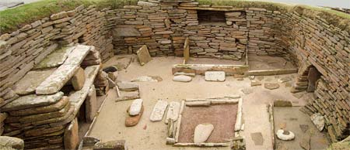
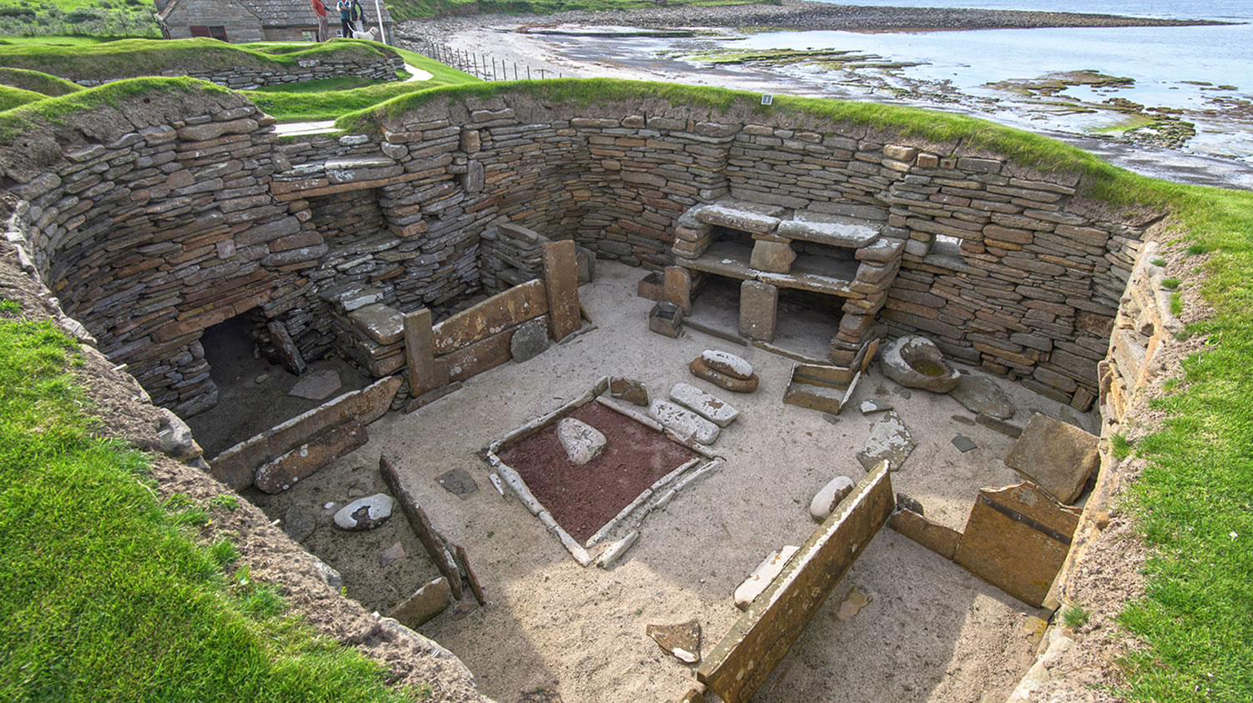
The Houses
The 8 houses that remain were built altogether and at the same time.The layouts of all the house were quite similar they were all built in rectangular shapes but curved on the outer bits .There are some furniture that still remain such as shelves made at out of stone and fire pits.The houses were basically a room built with fireplace and beds built into the walls.Lower doors were actually useful because they helped keeped storms out.

Slide 3
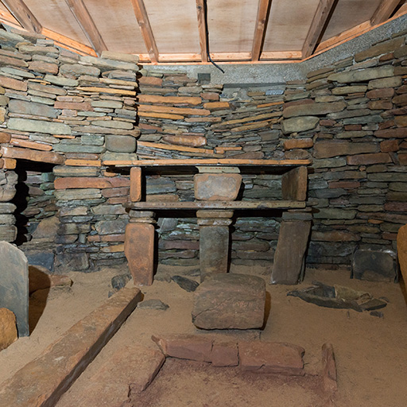
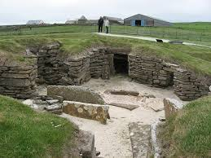
House 7 & 8
House 7
In house 7 two dead bodies of women were found in a grave under the wall.The bodies would have most likely to have been put there before the house was built.From inside you would not be open the door and could only be bolted from the inside.The people inside would not be able to open the door.Unlike the other houses that had a passage that went to the other houses,house seven only went to house 7.House 8 had carved patterns in the walls and floor.As it was i the middle and a bit smaller than others it was most likely to be a meeting place or work shop.
House 8

Slide 4
Light, space and warmth
To keep warm they would have had blankets made from animal skin.There was no electricity so that meant there would be no light so they had fires to make light and to be warm.The houses had no roof or window but were sheltered as they were under ground.

Slide 5
What else was found there?
A lot of jewelry was found such as necklaces,beads and pins.Things that were made out of animal were found like cattle,sheep and tools made out of bone.They did a lot of hunting for the animal skin so they could make clothes.

