Slide 1
An educational adventure to remember!
Location: Dukeshouse Wood, Northumberland
Date: 00/00/0000

Slide 2
What’s coming up..
Introduction to Kingswood
Your centre
Benefits of Outdoor learning
Learning Outcomes
Sleeping and eating
Your programme options
Your centre team
Safety and wellbeing

Slide 3
Introduction to Kingswood
A trip to Kingswood is a life changing adventure. For over 35 years, our transformative school trips have encouraged primary school pupils to build confidence and resilience by taking on fun challenges.
Each year over 175,000 young people visit Kingswood to experience exciting activities, from archery to zipwire, and they go home with so much more. They leave with the feeling that they can achieve their goals, and it’s wonderful to see the most uncertain pupils becoming the most enthusiastic.
We provide the perfect environment to develop positive mind-sets, improve well-being and encourage self-belief, plus there is always lots of laughter.

Slide 4
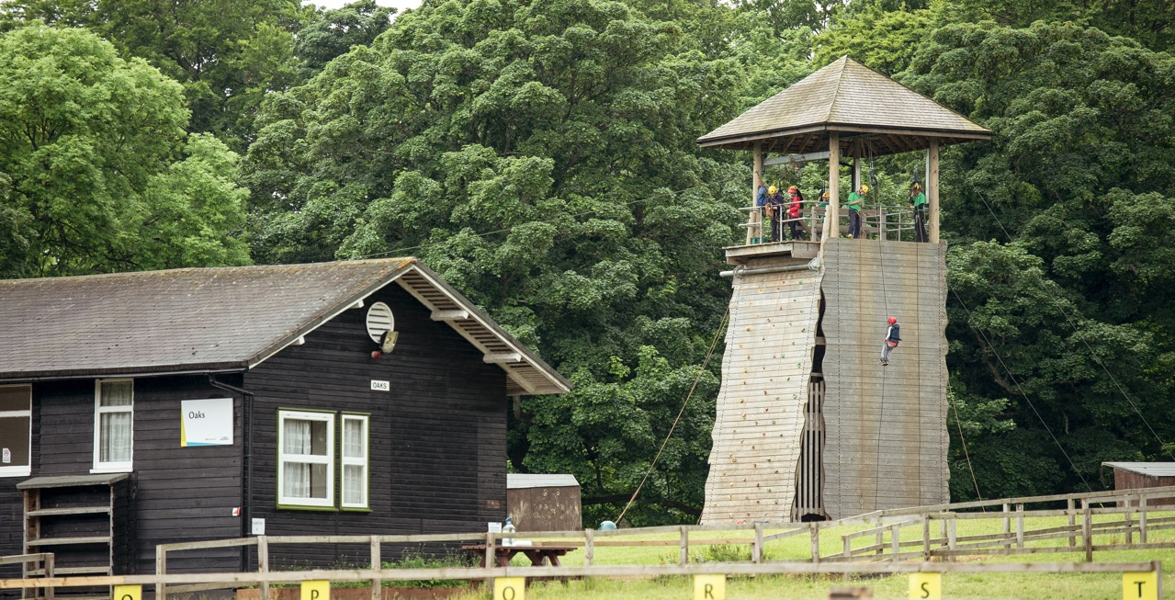
Welcome to
Dukeshouse Wood
Fellside, Hexham, Northumberland, NE46 1TP

Slide 5
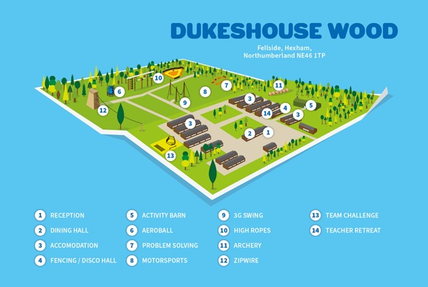
Your centre
A popular choice for Scottish and English schools and groups, Dukeshouse Wood is situated on a beautiful fell side just outside the leafy suburbs of Hexham, close to Newcastle and the Scottish Borders.
The 18 acre activity park in an area of unspoilt countryside houses exciting adventure activities such as zipwire, outdoor laser, Jacob’s ladder, an outdoor climbing and abseiling tower. When the weather is not so favourable, the centre also has a 8000 sq ft all weather barn, housing indoor climbing, a laser arena and computer lab facilities.

Slide 6
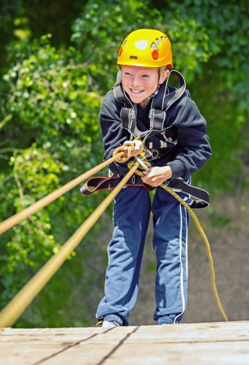
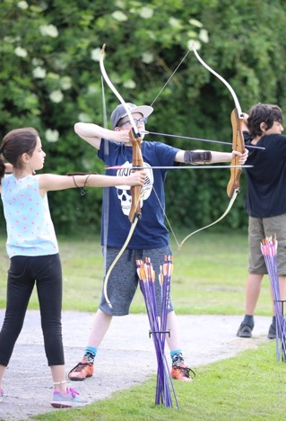
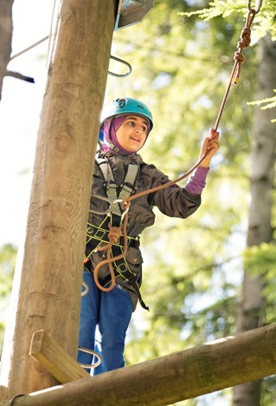
Highlights of
Dukeshouse Wood

Slide 7
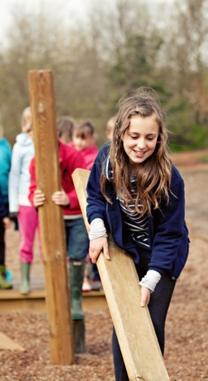
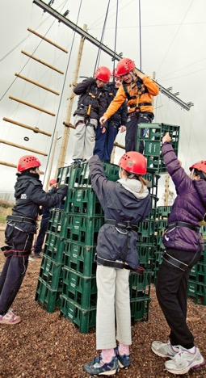
Highlights of
Dukeshouse Wood

Slide 8
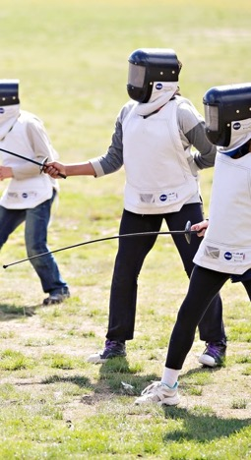
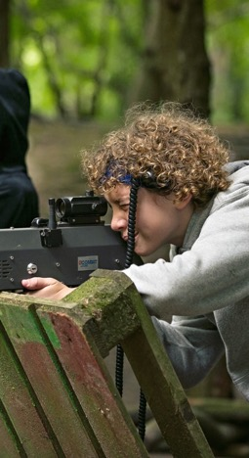
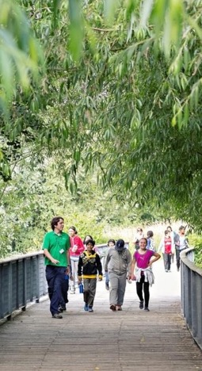
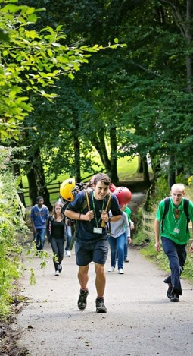
Highlights of
Dukeshouse Wood

Slide 9
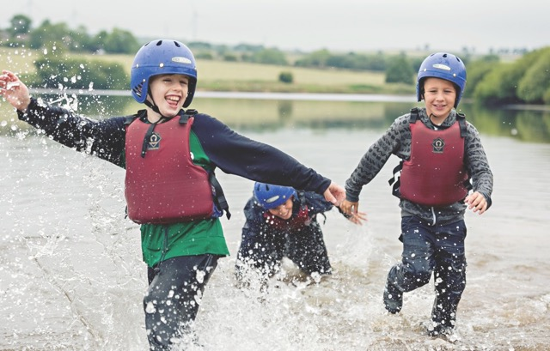
Learning Outcomes
Our programmes are designed to specifically meet your needs and link back to the core curriculum as well as developing environmental awareness and improve both mental and physical wellbeing.

Slide 10
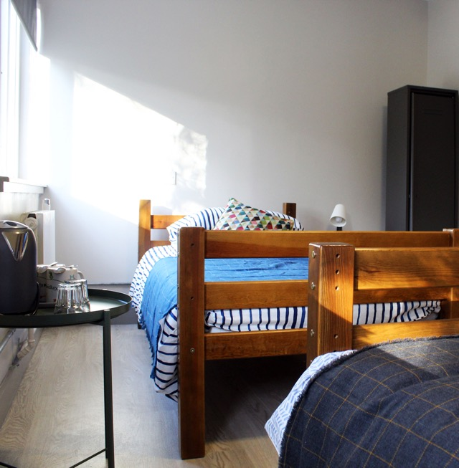
A bit more about your centre…
Sleeping
Dukeshouse Wood has standard dormitory style accommodation. Rooms range from 4 to 10 bed dormitories, all en-suite with under floor heating, and party leader rooms close by. Sheets, duvets and pillows are provided for all guests.

Slide 11
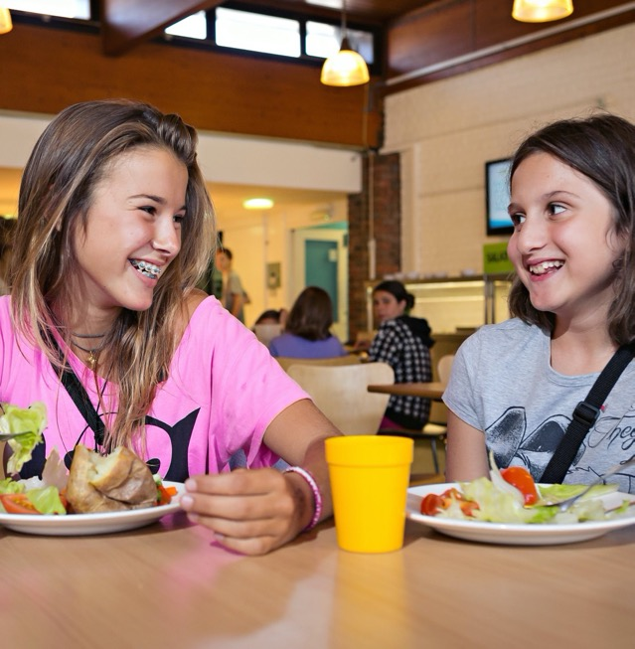
A bit more about your centre…
Eating
To fuel young guests during a long day of thrilling adventure activities, we serve three meals per day, with lots of choice and seasonal variations.
Each day there is a carefully balanced and nutritional meal plan, recently updated to meet and exceed the latest Government standards on young people's. We cater for most dietary requirements – just let us know.

Slide 12
Safety at Kingswood
Peace of mind
Safety comes first at Kingswood; we’re founding members of the British Activity Providers Association (BAPA) and affiliated to a whole range of governing bodies. We employ safeguarding leaders and every team member undergoes enhanced DBS checks. There are secure boundaries around our centres and regular night patrols as standard. We’re also designated COVID-safe by Kaddi.
Covid policy
The key steps we are taking to ensure everybody who visits are safe include:
Respecting existing group bubbles
All team members are tested for covid twice weekly
Ensuring social distancing is adhered to, with reminders throughout our centres
Deep cleaning cycles and sanitiser stations. All equipment will be regularly sanitised according to the government’s regulations
PPE will be worn by our team when carrying out safety checks. We will always respect your wishes if you would like to wear your own face covering

Slide 13
Here’s a taster!
www.youtube.com/watch?v=Gl7DP04afhw

Slide 14
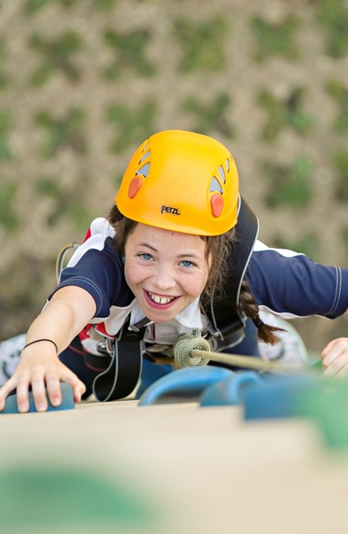
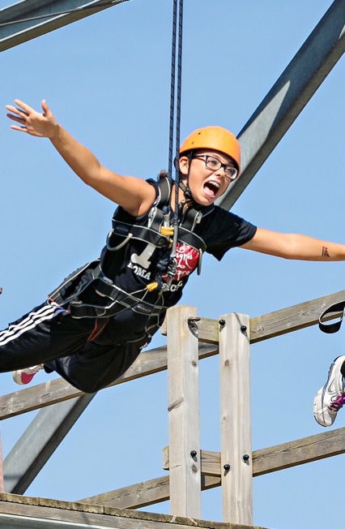
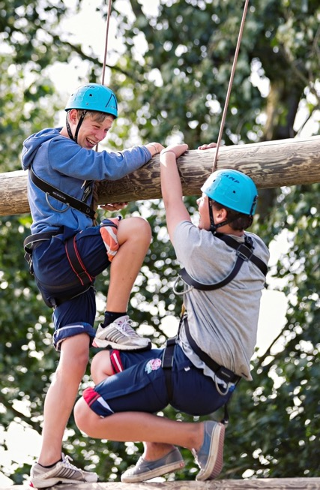
Here’s a taster!

Slide 15
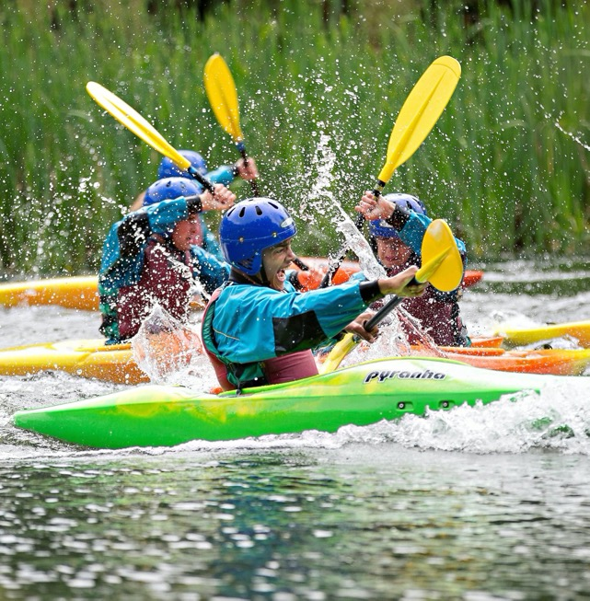
Discover more
Visit our website at www.kingswood.co.uk
Follow us on our social media channels
kingswoodcentres
@kingswoodcentres & @dukeshousewood
@kingswood_

Slide 16
Thank you!
Any questions?

