Slide 1
Year 6 residential 2025
Newby Wiske
Hall
11th – 13th June 2025

Slide 2
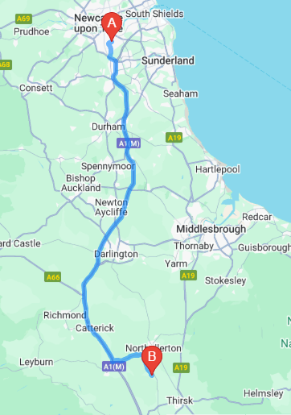
PGL Centre at Newby Wiske Hall
Wednesday 11th June. All children to come to school for 9.45. Parents can come in to the hall.
Depart at around 10.30am
Come back Friday 13th June
Just off the A1
Around 70 minutes travelling time
Arrival approximately 12pm.
Return 3.30pm we dismiss from the dinner hall doors
Must have packed lunch for first day. First meal there will be evening meal

Slide 3
Video
https://www.pgl.co.uk/en-gb/school-trips/primary-schools/centres/newby-wiske-hall

Slide 4
Staffing
Mrs Traynor
Miss Smith
Mrs Hope
Mr Gibson

Slide 5
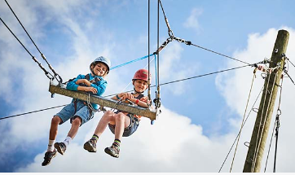
Purpose of trip
Social
Fending for oneself
Building self-confidence
Being away from home
Working as a team
Problem solving
Friendship building
Overcoming barriers

Slide 6
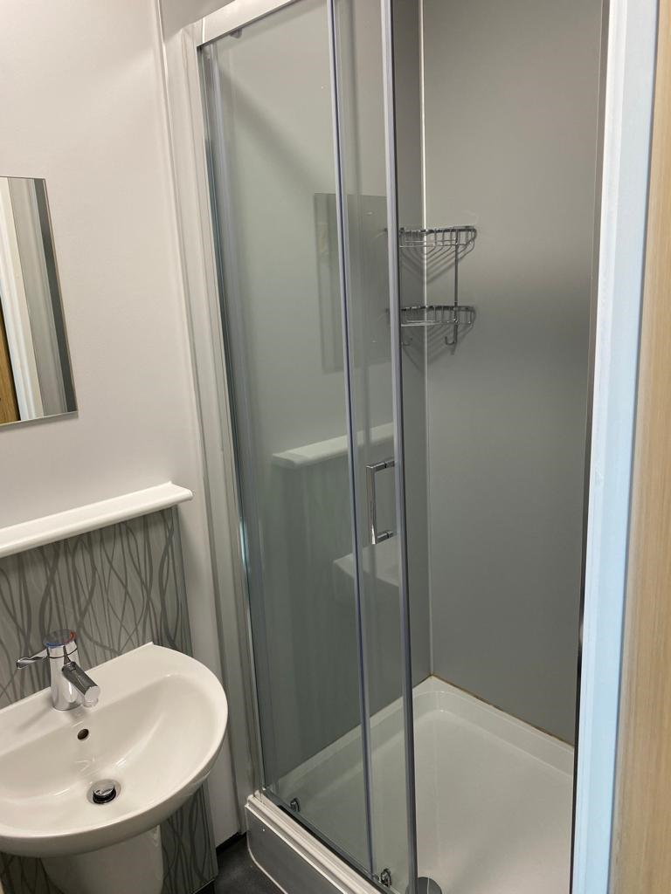
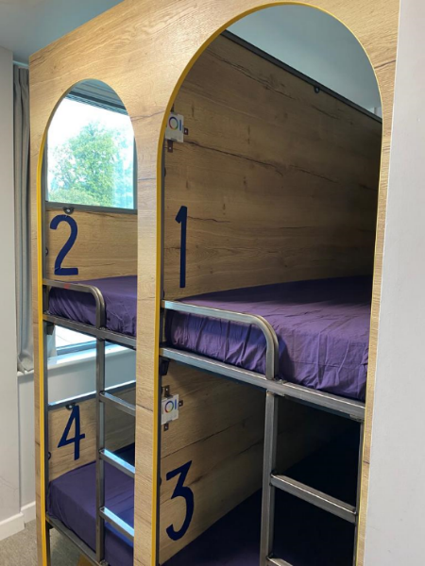
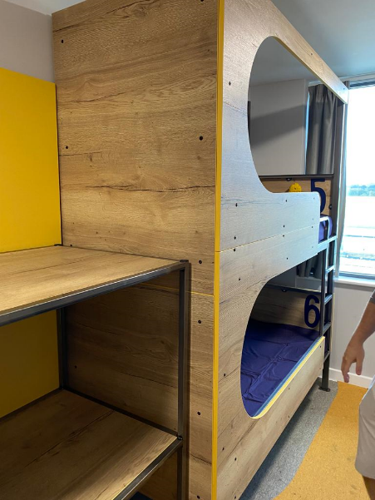
ROOMS
All the rooms are en-suite
4/6 children to a room.
All ensuite
MUST BRING OWN BEDDING. (sleeping bag, pillow or duvet). Let us know if this is a problem in advance.
Staff will have rooms on the same corridors as children.

Slide 7
Big bag (but not too big!) Small suitcase or sports bag

Slide 8
Backpack
Back pack not shoulder bag – tighten straps
Waterproof coat with a hood
Camera – named (optional) – disposable so not expensive to replace
Book
Drink (no cans, glass bottles or fizzy pop)

Slide 9
Spending Money
£10 MAX pocket money (in a wallet or purse) in cash or on pre-paid cards. Your child will be responsible for their money for the duration of the trip.
Use money to buy souvenirs etc from on site shop – we discourage children from buying sweets.

Slide 10
What to wear on the Wednesday.
Tracksuit or joggers/leggings and top (ready for first activity on arrival)
Trainers
Hats
Children can wear shorts (weather dependent)
Long sleeved tops as some activities require this.
Suncream

Slide 11
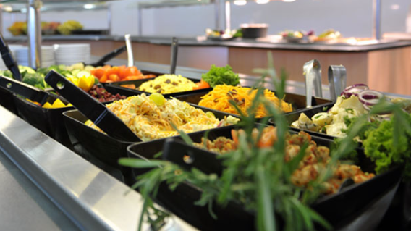
Meals
All meals are provided by the centre.
A wide variety of food.
Freshly prepared.
Always a vegetarian option.
Water and squash available at all meals (hot drinks at breakfast)
Special diets can be catered for.

Slide 12
What PGL say....
Allergen Information Please be assured that the menu choices for guests with medical dietary needs, food allergies or coeliac disease will be adapted where possible and choices are not limited to the items displayed here. PGL can provide meals that do not include the main 14 allergens as ingredients , where the dietary needs form has been completed during the booking process. If you require more specific information in advance, please contact our customer service team. We implement all reasonable controls for cross-contamination and control the ingredients within a recipe. We handle numerous ingredients within our kitchens and cannot guarantee that our meals are free from allergens, with the exception of our gluten free dishes that contain gluten at a level of no more than 20 parts per million (ppm). Processes and training are in place to ensure that meals on this menu are gluten free.

Slide 13
Menu
https://schoolsandgroups.pgl.co.uk/uk-pgl-menu/
Have a look with your child at home before the trip. There is a variety of choice for the children. If there are any issues let us know before hand as we need to let them know of any other dietary requirements in advance.

Slide 14
Medical Information
Medical Forms to be sent out – please return ASAP
Anything concerned about - talk to class teacher
Please let class teacher know about any dietary needs
Another medical update form for current medications will be sent out closer to the time of the trip
If your child has any medication it must be handed in to a member of school staff on the day of the trip in a clearly labelled bag (with dosage/time information) and details must be written on the medical form (THIS IS VERY IMPORTANT)
Bed Wetters or any other important information you think we need to know please get in touch before the day of the trip.

Slide 15
You will not need
Electronic Equipment (including smart phones)
Jewellery – Children cannot wear earrings during activities (PGL rule so their instructors will make the children sit out if they are in).
Chewing gum
Sweets/fizzy drinks

Slide 16
Most of all for you
Kiss them goodbye and wave them off
Try and not get upset otherwise they will get upset!
Don’t fret!
Enjoy the freedom
Visit PGL website to find out more
https://www.pgl.co.uk/en-gb/school-trips/primary-schools/centres/newby-wiske-hall

