Slide 1



Welcome to Heworth Grange
SEND Provision
Heworth Grange School
Mr A Haddon
Assistant Headteacher (SENCO)
alan.haddon@consilium-at.com

Slide 2


CONTEXT
22 EHCP 1.91% (Nat Avg 4.8%)
125 SEN Support 12.5% (Nat Avg 13.6%)
Biggest rise in need: Autism and SEMH
10 (1) EHCP in new Year 7 intake
2 primary needs assessment in process
Increased number of Yr 7 SEND K
PA rate for SEN K students down 1.1% STLY
PA rate for EHCP students down 27% STLY
SEN attendance is 13% below national average

Slide 3
Our SEND Vision
A clear drive to ensure inclusivity
A clear drive for all students to access quality first teaching.
Provide support for students to be able to access lessons and be successful.
Work with external partners to ensure the best support for the students we serve.

Slide 4
Main Provisions
Haven: Daily support for arising and changing need.
Sensory Room: Support for arising sensory need.
Assessment and Intervention: Pre planned intervention and use for identification of need.
The View: EBSA and ASD school refusal bridging provision.
Innovation Centre: SEMH support.

Slide 5
Our SEND Provision
Whole School SEND approach
Haven – SEMH provision
Sensory Room- regulation
Pupil passports for all K and E - shared
Assessments for need identification
The View - EBSA
Interventions/provisions for individual students.
Morning Drop In Offer (Weekly) - parental engagement
Parents Evening Meetings
Co-Curricular Offer – K and E targeted

Slide 6
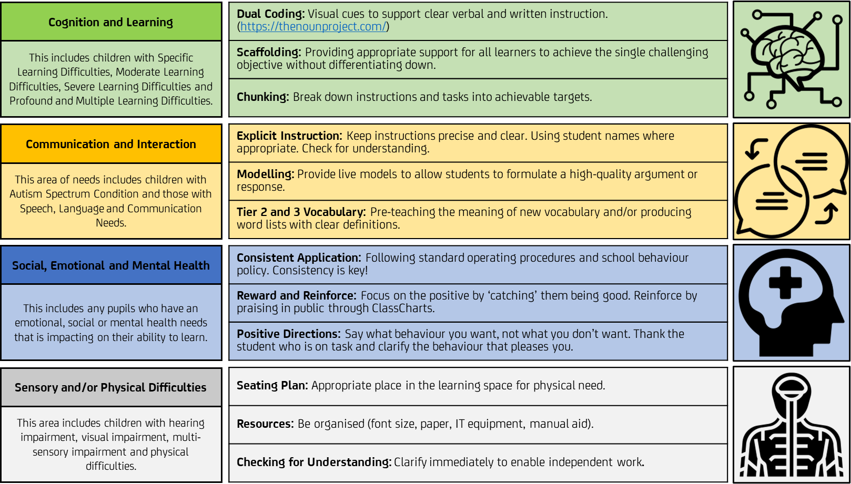
Whole-school SEND approach

Slide 7

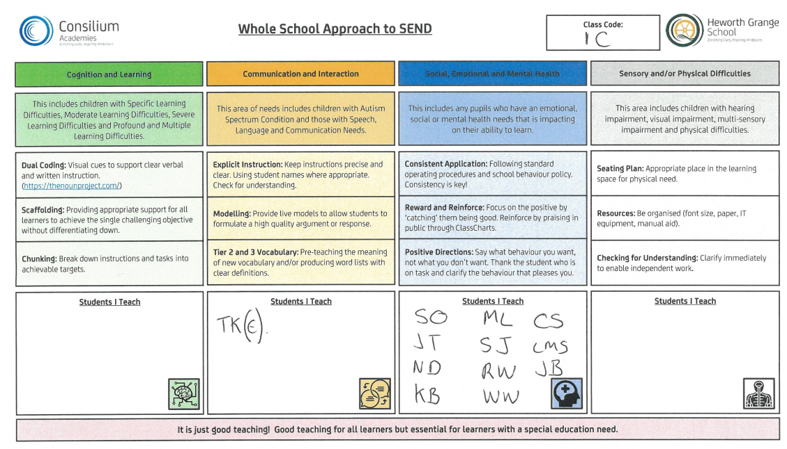
SEND identification expectations

Slide 8
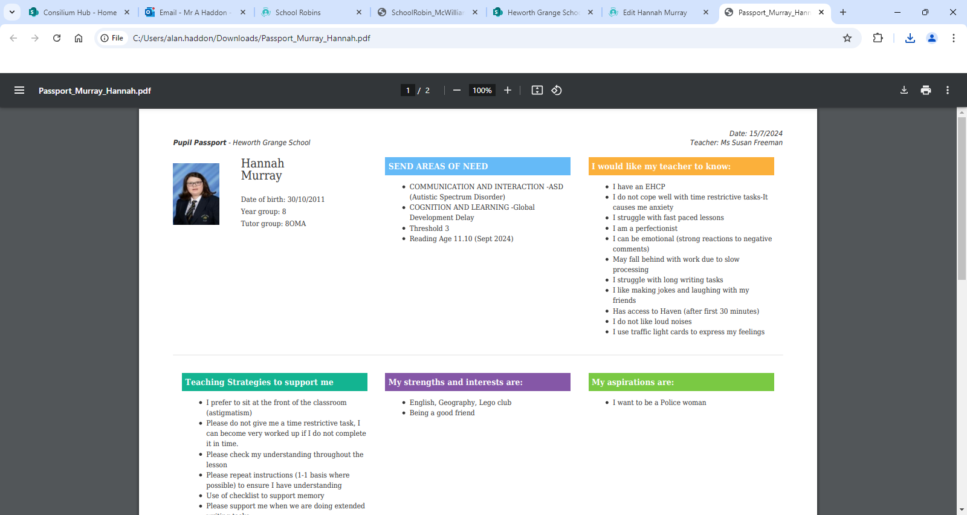
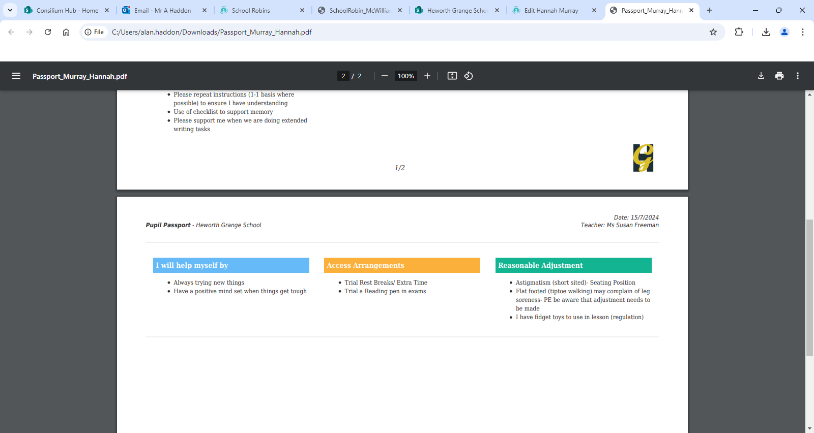

Slide 9
Interventions/Provisions
IDL Literacy | Haven time out access | Seating adjustment
IDL Numeracy | 3-minute lesson pass | Alternative Provision
Reading Wise | Medical pass | Specific Numeracy
Social groups | Fidget | Specific Literacy
Communication groups | Movement breaks | Decoding (Reading Wise)
Lego Therapy | Art Therapy | Assessment
Lesson support | Careers support | Transition Support
Sensory Room | Sensory/Chalk | Sensory/Medical Adjustments
Target Reports | Morning Check Ins | Exam Access Arrangements
Phonics/Foundation skills | The View | Thrive training for all staff
Additional parental communication | Well-Being | Emotional Literacy

Slide 10
Identification/Transition
SENCO visits all primary feeder schools to discuss students.
Pre visits – for pupils and parents
Parental visits
Pre passport completion
Parents Evening after day 1 of transition.
Year 7 baseline assessment
Allocated key staff through SEND and TA team
HOY Mrs Rostron
SENCO presentations at Open Evening

Slide 11
External and Internal QA
OFSTED 2024:
All pupils, including pupils with special educational needs and/or disabilities (SEND), access the same curriculum. The school identifies and meets the needs of pupils with SEND well. Pupils at an early stage of reading get the extra help that they need. This helps them to catch up with their peers and become confident and fluent readers.
Internal from Trust since September 2024:
Raising Standards board Focus – provision for SEN support in Mainstream and QFT
Department Development Review – audit of the SEND department- robust action plan in place

